Slide 1
MetagenomeTrakr:
A Pilot Study for the Rapid Detection of Foodborne Pathogens
Laura Howard
Office of Regulatory Affairs
Office of Regulatory Science
Northeast Food and Feed Laboratory
GenomeTrakr Sept. 18, 2019
** The information in these materials is not a formal dissemination of information by FDA and does not represent agency position or policy.
Notes:
Good Afternoon Everyone. I’d like to first say thank you to the GenomeTrakr organizers for inviting me to give a talk today. It’s exciting to be here and it’s also exciting to share with you this pilot study that was started just a little over a year ago. I’m a regulatory microbiologist and my first real exposure to metagenomics was when this study started so I’m fairly new to this field. This is a huge collaboration with 3 different centers involving many scientists. Let me first give you a very brief introduction to our lab.

Slide 2
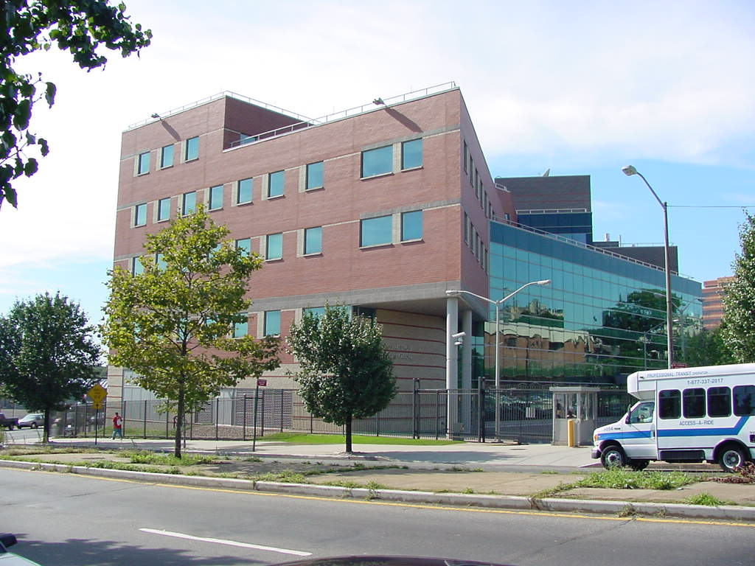
Northeast Food and Feed Laboratory

Slide 3
Northeast Food and Feed Laboratory
8 ORA Food and Feed Laboratories
Jamaica Queens NYC
90 Microbiologists and Chemists
3 Branches: Chemistry I, II & Microbiology
Pathogens, pesticides, food additives, mycotoxins, colors, filth, decomposition & heavy metals in foods
Specialties:
  BSL-3 facility
  Marine Toxins Laboratory
  Mass Spectrometry Center
  Microbiological Bio-clean Room
  Counterterrorism toxic chemical and poison analysis

Slide 4
Metagenomics
Studying the genetic material recovered from foods and environmental swabs
Utilize metagenomic sequencing to describe microbiomes of food commodities and environmental swabs
Identify foodborne pathogens
Understanding why these microbes are there and what are they doing
Notes:
The reason why we are interested in metagenomics is

Slide 5
MetagenomeTrakr Pilot Program
Multi Center Collaboration:
CFSAN, CVM, ORA
Goals
  Develop SOPs for metagenomic sequencing of foods and environmental swab culture enrichments
  Employ metagenomic sequencing workflows to identify foodborne pathogens
    Develop and test data analysis pipelines
    What sequencing depth is required for positive identification of foodborne pathogens
    What background bacteria are competing with pathogens during culture in the laboratory
  Upload data to NCBI MetagenomeTrakr database
Benefits
  Detection of foodborne pathogens before an isolate is available
  Detect multiple pathogens in a single sample
  Identification of co-enriching bacteria that may hamper pathogen detection
  Characterize microbiomes of foods and manufacturing facilities
Notes:
As I mentioned earlier, this MetagenomeTrakr pilot study is a huge collaborative effort involving 3 centers: CFSAN, CVM and ORA.

Slide 6
Progress
Appointed an ORISE Fellow Brandon Kocurek to work on the project at NFFL
Drafted protocols for sample processing, DNA extraction and metagenomic sequencing
Collected >1,078 Samples for metagenomics
Performed 11 16S rRNA amplicon sequencing runs on 912 samples
  757 environmental swab culture enrichments from ~45 firms
  155 seafood enrichments (>70 different seafoods)
8 Shotgun metagenomics sequencing
  52 samples
Notes:
Here are some highlights of the progress that we’ve accomplished thus far.

Slide 7
16S Metagenomics
Targeted sequence of a single 16S rRNA gene
Pros
  High volume of samples (96 samples/run)
  Inexpensive ($/sample)
  Specific targeted 16S amplicon
  Great snapshot of bacterial genera in sample (taxonomy diversity)
Cons
  Lower depth of coverage
  Difficult to obtain strain identification (lower resolution)
  Primer choice can cause some bias
  No viral, AMR or plasmid identification
  No eukaryote identification
Notes:
Here are some pros and cons for using 16S metagenomics

Slide 8
Shotgun Metagenomics
Pros
  High Depth of coverage (higher resolution)
  Can assemble genomes (contigs)
  Can identify at the strain level
  Identify viral, plasmid, AMR
Cons
  Fewer samples/run (6-8 samples)
  More expensive ($$$/sample)
Notes:
Here are some pros and cons for using Shotgun metagenomics

Slide 9
Metagenomics Price Comparison
16S Metagenomics
Shotgun Metagenomics
Approximate cost $3,117/run
$32.50/ sample based on a 96 well run
Approximate cost $1757/run
$220/sample based on a 8 sample run
Not including cost of instrumentation; MiSeq, Qubit, thermalcycler, Vortex Genie and Magnetic rack

Slide 10
Using 16S and Shotgun Metagenomics To Describe Microbiomes
Seafood Commodities
Ice Cream Facility
Smoked Fish Facility
Ready-To-Eat Facility
Food/Meal Preparation Facility
Notes:
We used both 16S and shotgun metagenomics to describe microbiomes from various seafood commodities and facilities…….

Slide 11
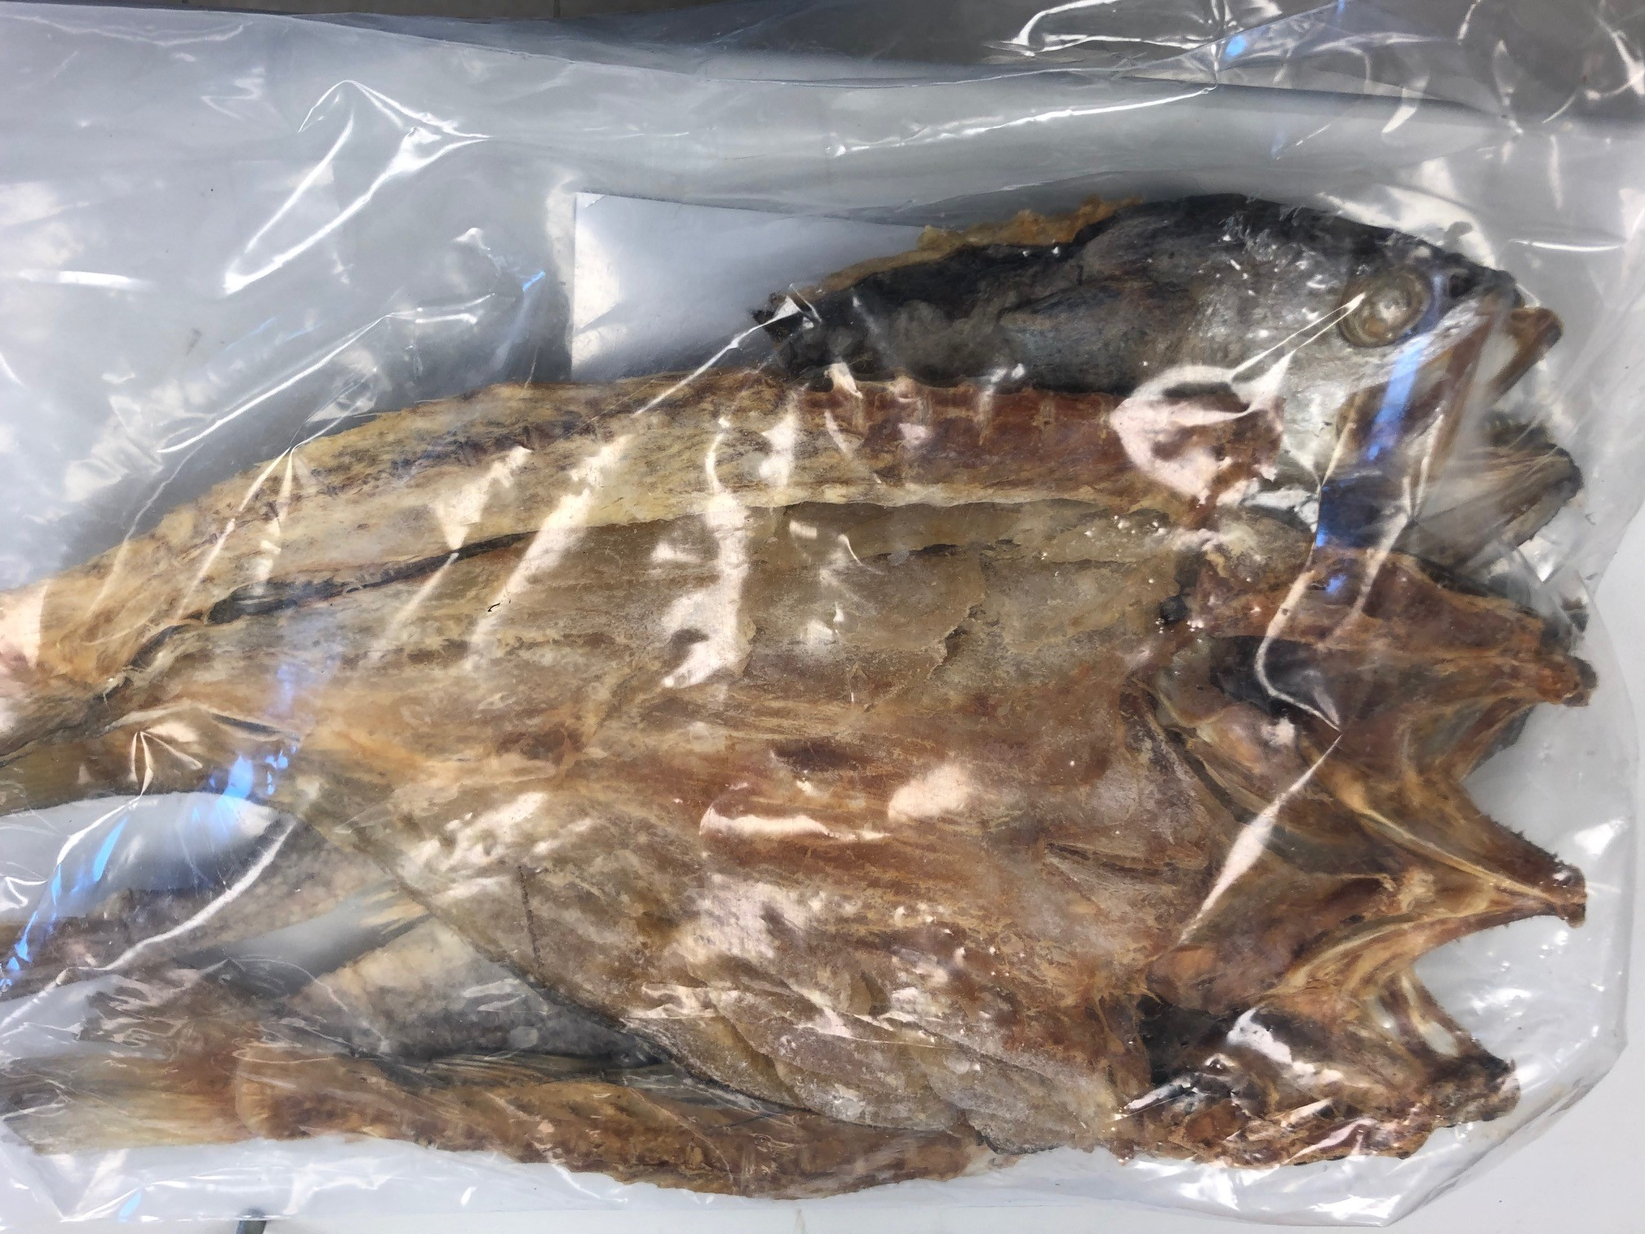
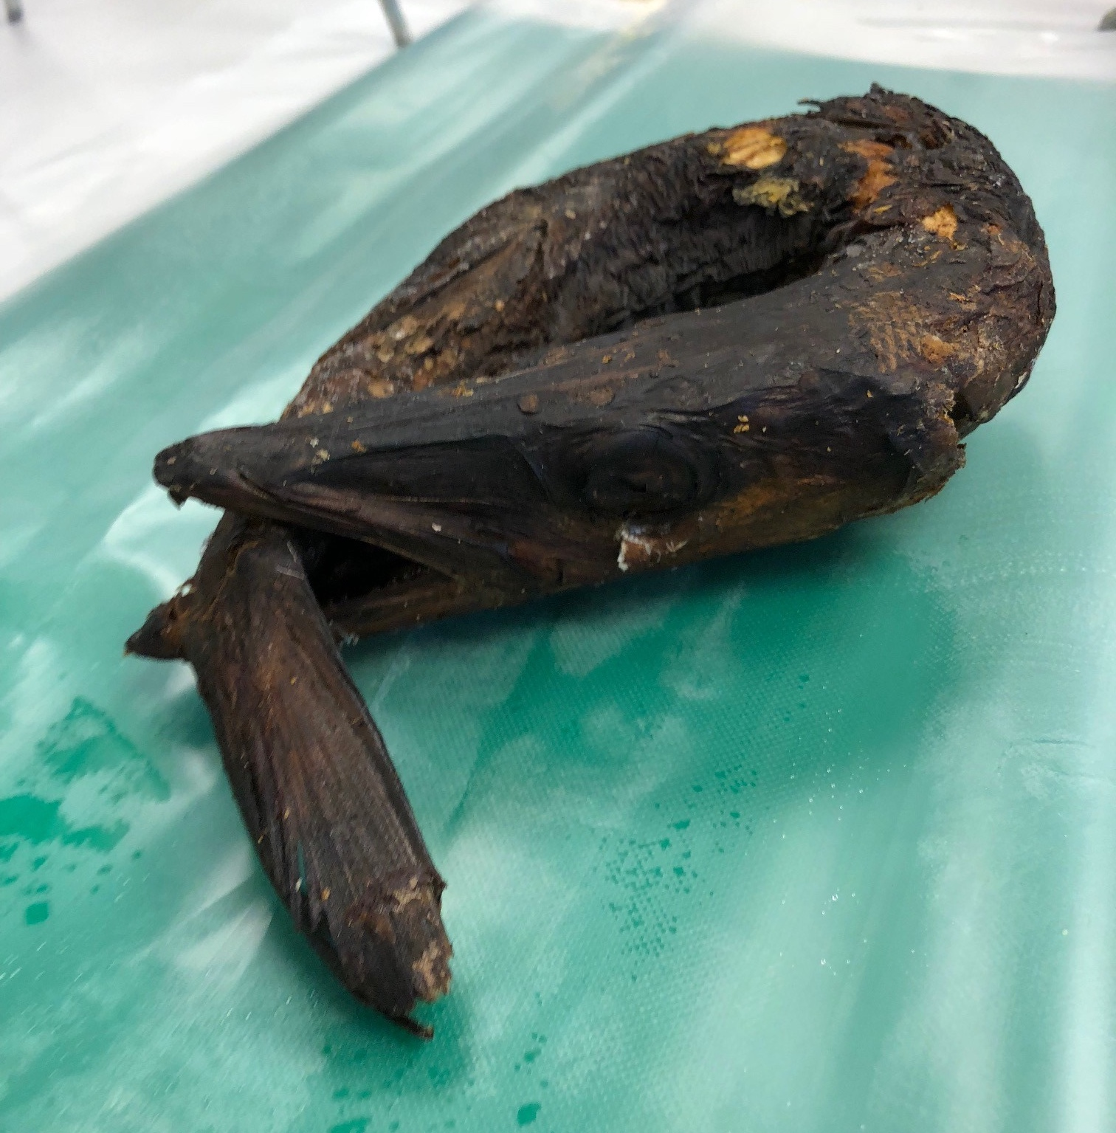
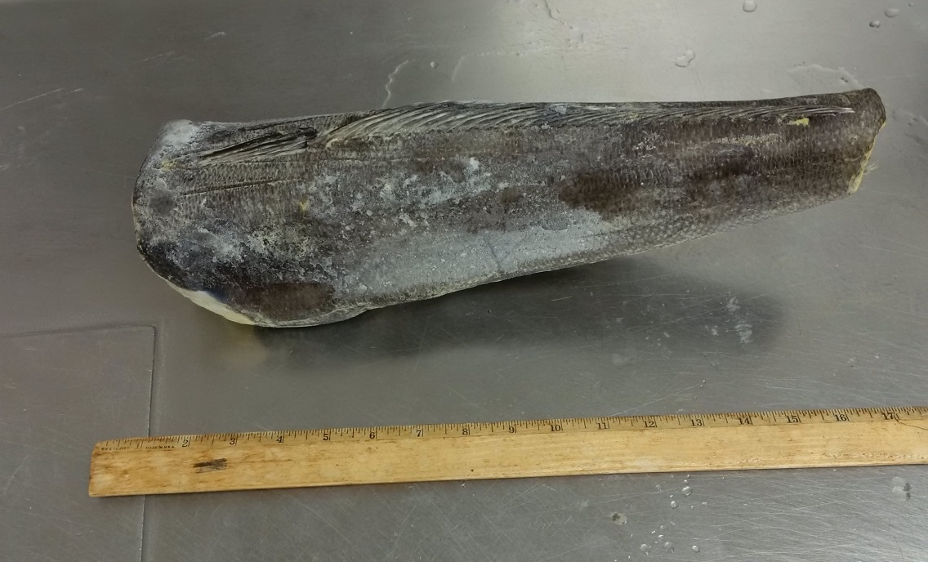
Salted Croaker
Barracuda
Haddock

Slide 12
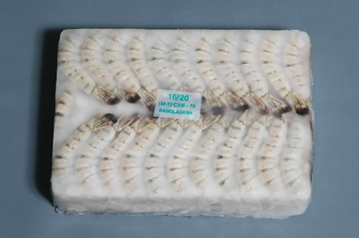
Frozen Uncooked Shrimp

Slide 13

Sample Setup - Salmonella
1 Frozen Shrimp Sample =
15 Blocks of Frozen Shrimp

Slide 14


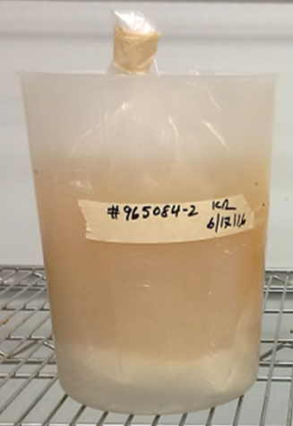
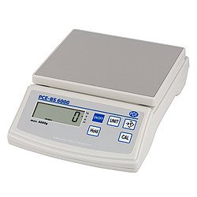
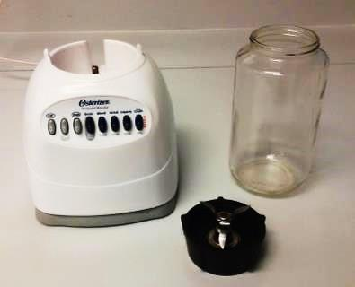

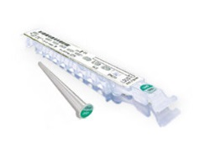
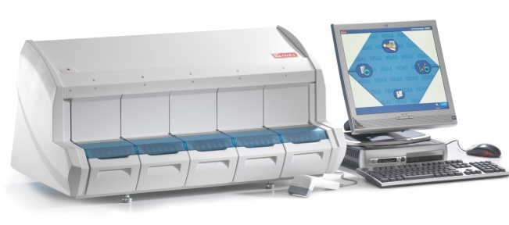
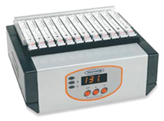
Regulatory Sample Setup
Salmonella
Frozen Shrimp
Hammer/
chisel
375g Comp in
3375 ml Lactose
15 subs
25g/sub
35°C
(Wait 1h & pH)
24 + 2h
0.1 ml
Confirm colonies: biochemicals,
serology, VITEK & WGS
42°C
24 + 2h
+ SX2
XLD, HE & BS
Screen by VIDAS

Slide 15
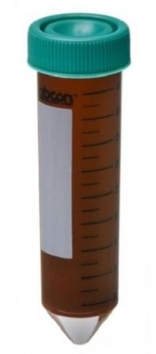
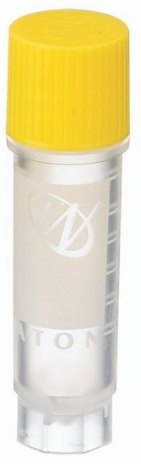
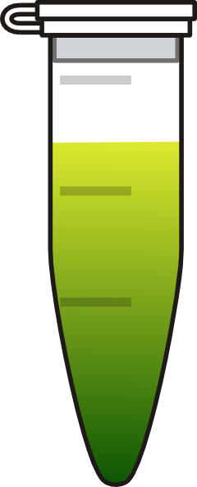
Metagenomic Sample Setup
Frozen Shrimp
Hammer/
chisel
375g Comp in
3375 ml UPB
15 subs
25g/sub
35°C
(Wait 1h & pH)
24 + 2h
1hr pre-enrichment
24hr enrichment
Freeze
Culture
Freeze
Culture
Pellet
2mL
Pellet
25mL

Slide 16
Seafood Microbiomes at 1 Hour
(16S)
Unclassified
Reads
Other
Taxa
Psychrobacter
Staphylococcus
Vibrio
Chloroplast
Vagococcus
Enterobacter
Carnobacterium
Mitoch
Notes:
Here you’re looking at 11 different seafood commodities and their microbiomes by using 16S metagenomics. Each colored bar is a bacterial genus and the size of the bar is correlated to the percent abundance of reads for that genus. Each entire column represents the microbiome for that seafood sample and this bar chart is showing the percent reads at 1 hour pre-enrichment. As you can see all the many different colors, these seafood samples are highly diverse. I’ll walk you through a few of the genera that we are seeing at pre-enrichment.
Vagococcus is not considered to be a foodborne pathogen for humans, however, there is one case report in the literature about 4 years ago that describes a clinical case in France of an individual who came down with vagococcal infection from eating contaminated fish with Vagococcus. Because that patient had underlying medical issues, the authors reported that this organism can cause an opportunistic infection.

Slide 17
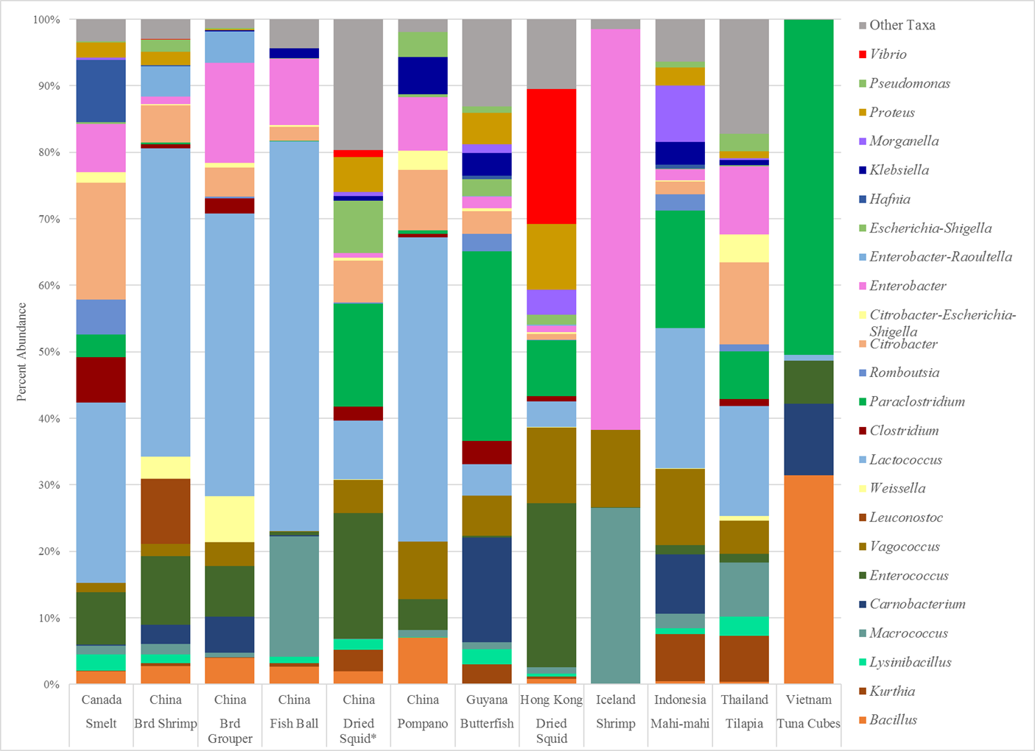
Seafood Microbiomes at 24 Hour (Salmonella)
(16S)
Lactococcus
Enterococcus
Vibrio
Enterobacter
Vagococcus
Paraclostridium
Bacillus
Notes:
Now here are the microbiomes for the same seafood samples after 24 hour enrichment. You still see a fair amount of diversity. There’s outgrowth of Lactococcus….

Slide 18
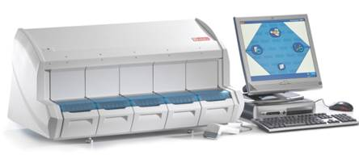
Environmental Swab Setup
Listeria monocytogenes
Add 100 ml
UVM broth
30°C, 48 h
100-200
DE broth
Collect metagenomic sample after regulatory work is completed
(48 hours)
Positive VIDAS samples
are plated
Sample for metagenomic DNA extraction
Freeze
Culture
RAPID
PALCAM
Confirm colonies: CAMP test, catalase, hemolysis, Gram stain, serology, VITEK
(All confirmed colonies are WGS)
Notes:
Now I’ll switch over to showing some data from environmental swabs analyzed for Listeria monocytogenes.

Slide 19
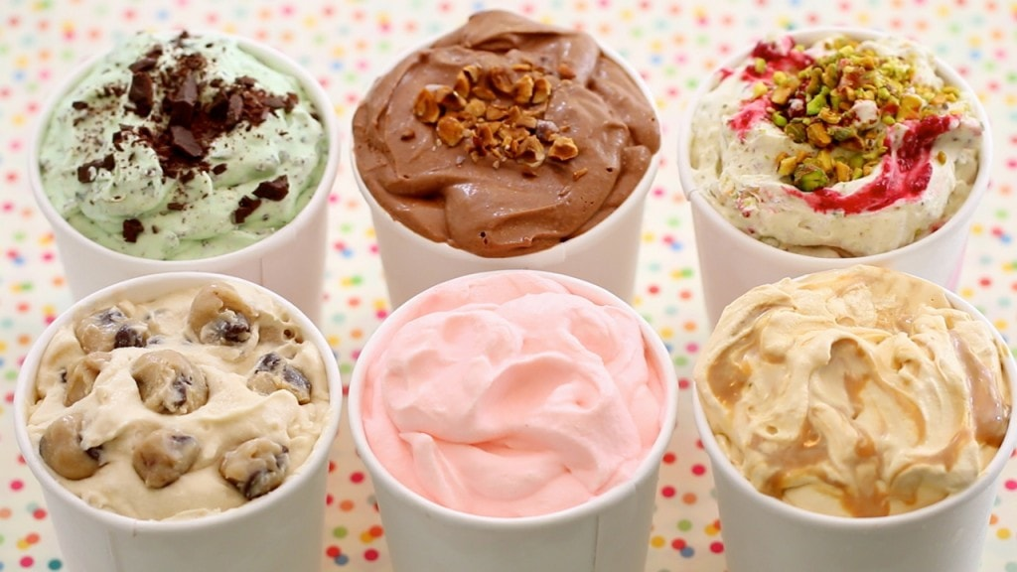
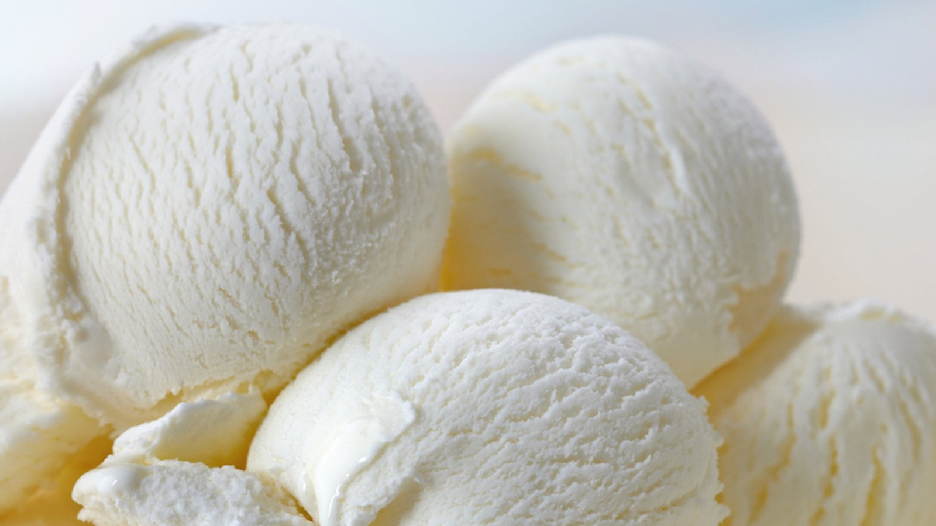
Ice Cream Facility
Company had previous Listeria contamination issues
Compliance program for dairy
Collected 100 swabs on Day 1
Collected 109 swabs on Day 2
Setup for Listeria analysis

Slide 20
Swab Culture Enrichments (48h) from Ice Cream Facility
16S (Day 1)
Aerococcus
Enterococcus
Lactococcus
Morganella
Carnobacterium
Pseudomonas
Vagococcus
Plesiomonas
Serratia
Culture
Results
Lm
Neg
Neg
Neg
Neg
Li
Li
Lm
Lm
Li
Li
Li
Notes:
For the Day 1 environmental swabs, one of the first things that you notice is that these microbiomes have less diversity than what we saw with the seafood samples. You see a huge percent abundance of Enterococcus reads in almost all of the samples, Lactococcus in about half of them, Aerococcus,. You also see 2 samples with lots of Morganella. Interestingly you also see Vagococcus in about half the samples. There’s Carnobacterium, Pseudomonas in about 75% of the samples and Serratia and Plesiomonas.
Now the light blue hatched bars show Listeria reads which are highlighted in red boxes. When you compare these swabs to the regulatory cultural results, you see that 4 of those 5 swabs had either Listeria innocua or Listeria monocytogenes in them. We also saw 4 swabs that were positive for the presence of Listeria species where we did not identify Listeria reads above 1%. We learned early on that our DNA extraction protocol needed to be perfected and so we switched to another extraction protocol using beads which allowed for more efficient DNA extraction from Gram positive bacteria and spores.

Slide 21
Swab Culture Enrichments (48h) from Ice Cream Facility
(Listeria) 16S (Day 2)
Culture
Results
Lm
Li
Lm
Neg
Neg
Neg
Neg
Neg
Neg
Neg
Neg
Li
Notes:
And now for the second batch of environmental swabs on Day 2, again you see a lot less diversity than what we saw with the seafood samples. You do see a huge abundance of Enterococcus reads in most of the samples shown by the dark green bars and swabs #139, 142 & 146 are mostly Enterococcus whereas swabs 144 & 152 you see mostly Pseudomonas.
The light blue hatched bars in red boxes represent 9 swabs with Listeria reads in them. When you compare these 9 swabs to the regulatory cultural results, you see that 4 of the 9 swabs had either Listeria innocua or Listeria monocytogenes in them but interestingly we also see 5 swabs (136, 139, 142, 148 & 152) showing Listeria reads but no Listeria species were cultured from them which we thought was interesting.

Slide 22
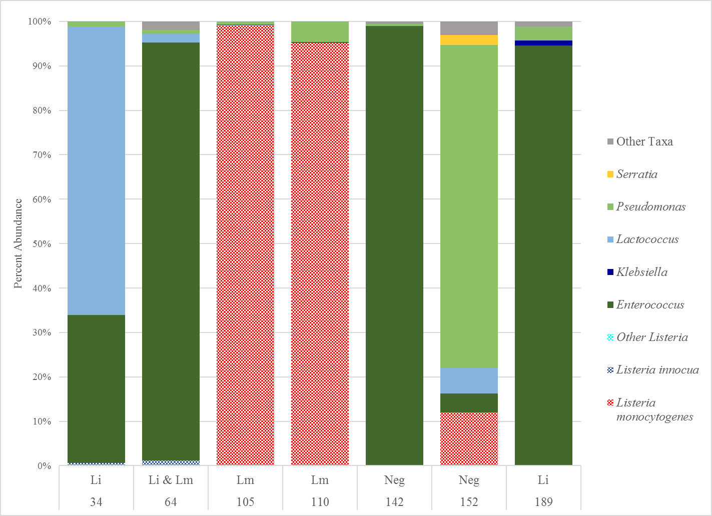
Swab Culture Enrichments (48h) from Ice Cream Facility
(Listeria) Shotgun
L. innocua
L. mono reads
Culture
Results
Notes:
We decided to do Shotgun sequence on 7 swabs to get better resolution on what was in them. You see lots of Enterococcus in 4 samples, one sample had mostly Pseudomonas, one sample had almost 70% Lactococcus, a couple of them had a small amount of L. innocua reads which correlated with the cultural results and 4 of the swabs had Lmono reads and 3 of them were culture positive for Lmono. No Lmono was cultured in swab 152 that had about 12% Lmono reads. And swab 189 was culture positive for L innocua but we didn’t find reads above 1%. One of the major advantages of doing Shotgun sequencing is that you can assemble the sequences into contigs and do single nucleotide polymorphism (SNP) analysis with the isolates that were cultured from that swab. So we chose 3 swabs (#64, 105 and 110) to assemble the sequences, make contigs and compare with the whole genome sequencing data to the isolate from that swab.

Slide 23
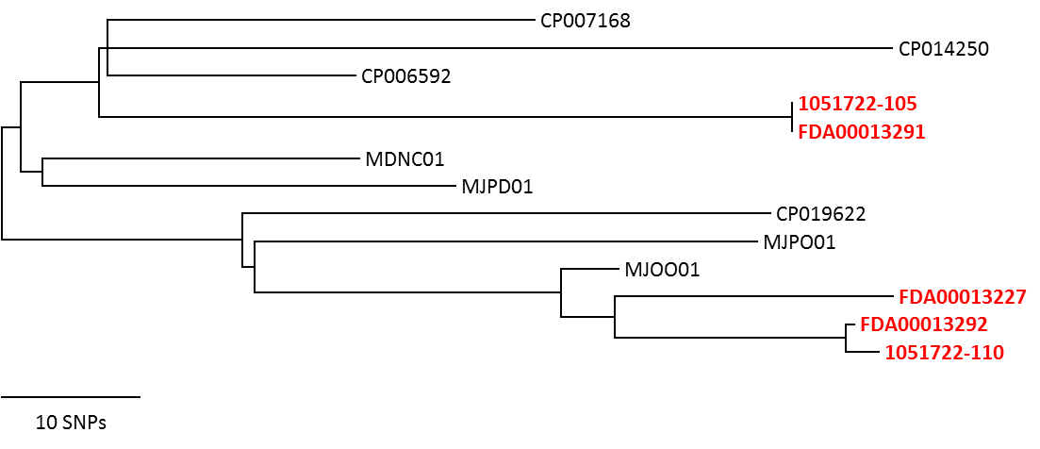
Shotgun Metagenomics
Listeria in Ice Cream Facility Swab Culture Enrichments
Lineage 1 L. monocytogenes in an Ice Cream Facility
Sample ID | Culture result | Abundance | # Lm reads | Matching FDA WGS | # SNPs
1051722-105 | Lm | 95.48 | 3,358,909 | FDA00013291 | 0
1051722-110 | Lm | 91.30 | 2,989,408 | FDA00013292 | 3
1051721-64 | L. innocua & Lm | 0.18 | 5,791 | FDA00013227 | ND
0 SNPs
3 SNPs
Notes:
This is a data table for those 3 swabs. All of them had L. mono cultured from them. Swabs 105 & 110 had a high percent abundance of Lmono reads (95% and 91%) which showed more than 3.3 million Lmono reads for 105 and 2.9 million for 110. Swab 64 had very low reads with only about 5,700. When we assembled these reads into contigs and did a SNP analysis, we found that swab 105 had 0 SNP differences compared to the isolate that came from that swab and 110 had 3 SNP differences with the isolate originating from that swab. We weren’t able to do SNP analysis for Swab 64 because the reads were too low and we weren’t able to assemble the reads into contigs.
And this is what you see when you put the results on a phylogenetic tree.

Slide 24
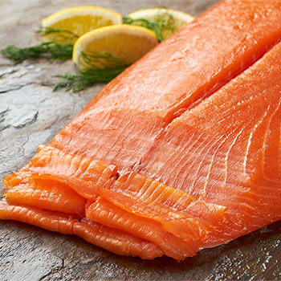
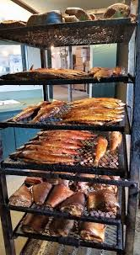
Smoked Fish Facility
Company had previous Listeria contamination issues
Collected 138 swabs
Setup for Listeria analysis
Looked at spatial distribution in facility

Slide 25
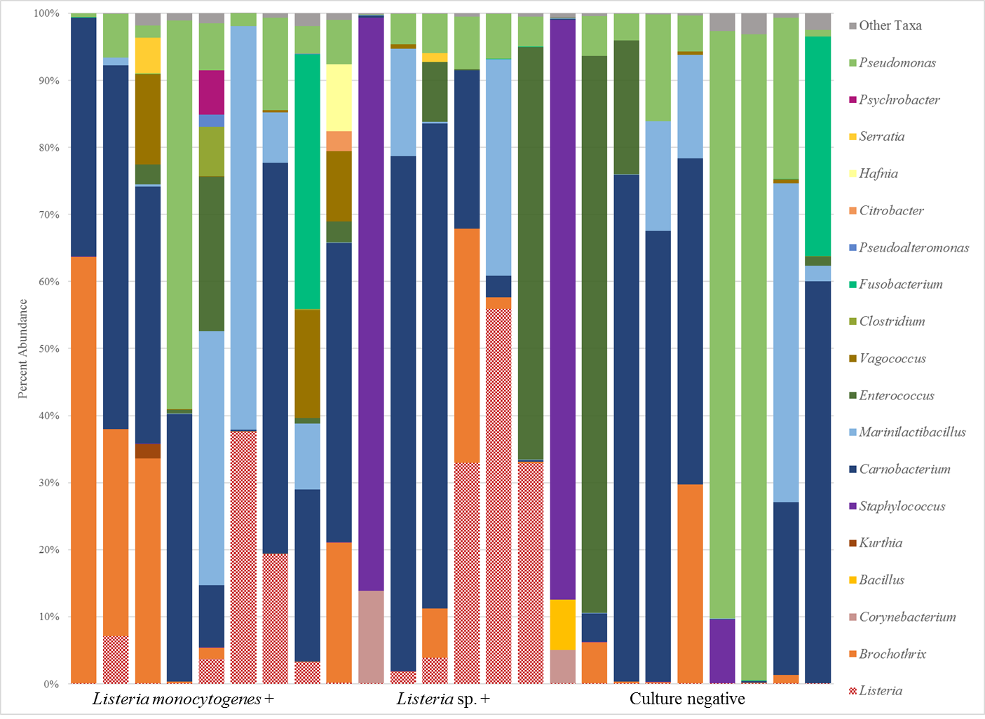
Smoked Fish Facility Environmental Swab
(48h) 16S
Notes:
Here’s a bar chart showing the relative abundances of the top 18 taxa in the smoked fish facility. You see Pseudomonas at various levels in every single swab, A few swabs had large number of reads for Enterococcus shown by the dark green bars. We saw lots of Citrobacter, Carnobacterium, and Listeria species.
8 swabs had Lmono cultured from them which showed various levels of Listeria reads. 5 of those 8 had reads ranging from 3% up to 40% while 3 swabs had less than <1% of Listeria reads. The positive cultures containing Listeria species in them showed varying percentages of Listeria reads, most of them had relative abundances ranging from 3% to almost 60%. All the negative cultures had Listeria reads less than 1%.

Slide 26
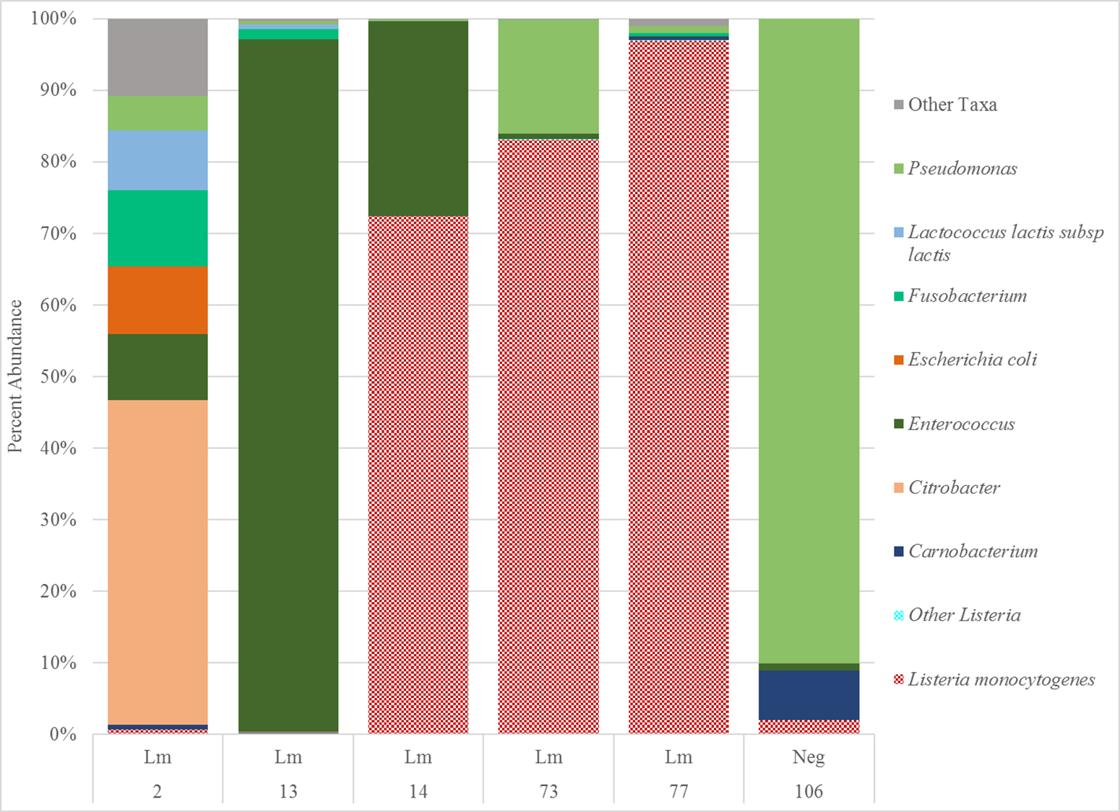
Listeria in Smoked Fish Facility Swab Culture Enrichments
Shotgun
L. mono
Culture
Results
2 and 13 = the floor of room #1
14 = a doorjamb in room #1
73 = the wheel of a cart in room #2
77 = the floor in room #2
106 – no metadata available
Notes:
Here’s Shotgun metagenomics for 6 swab samples taken from a different Smoked Fish facility. Similarly, you see Pseudomonas, Enterococcus, Citrobacter, E. coli and L.mono. All 6 swabs showed reads for L. mono which ranged from less than 1% in sample #13 and as high as 97% in swab #77. All were culture positive for L. mono with the exception of #106 which had about 2% L mono reads. For swabs 14, 73 and 77 which had the most abundant reads, we were able to assemble them into contigs and also did a SNP comparison with the cultured isolates.

Slide 27
Shotgun Metagenomics
Smoked Fish Facility Swab Culture Enrichments
Lineage II L. monocytogenes in a Smoked Fish Facility
Sample ID | Culture Result | Lm Abundance (%) | # Lm reads | Matching FDA WGS | # SNPs
1038227-77 | Lm | 96.87 | 4,584,941 | FDA00013453 | 8
1038227-73 | Lm | 83.12 | 2,693,651 | FDA00013452 | 3
1038227-14 | Lm | 72.42 | 1,816,631 | FDA00013448 | 7
FDA00013448
FDA00013452
3 SNPs
1038227-73
1038227-14
7 SNPs
MDEU01
NYPR01
CP019623
NYOX01
LDIQ01
1038227-77
8 SNPs
FDA00013453
10 SNPs
Notes:
Here’s the data table for those 3 swabs. You can see that all 3 had a high percentage of Lmono reads ranging from 72% to 96%, and the Lmono reads ranged between 1.8 million to 4.5 million reads. Here are the GenomeTrakr Lmono isolates that came from those swabs and after doing contig assembling with the metagenomic reads, you see the SNP analysis for each swab ranging from 3 SNPs to 8 SNPs.
And this is what you see when you put the results on a phylogenetic tree.

Slide 28
Ready-To-Eat Facility Swab Culture enrichments
Shotgun
L. mono
Culture
Results
32 = the floor
97 = part of slicer
10 = prep table
21 = metal conveyor belt
Notes:
We also looked at a Ready-To-Eat facility and did Shotgun on 4 environmental swabs. You see reads for Pseudomonas and Carnobacterium in all the swabs, Brochothrix in 3 of the 4 swabs and Enterococus in 2. Here are Lmono reads in swab 32 (~5%) and swab 97 (~12% reads) that were from the floor and the slicer which correlated perfectly with the cultural results.

Slide 29
Food/Meal Preparation Facility
Environmental Swabs (16S)
Percent Abundance
Culture
Result
Notes:
Our ORISE fellow, Brandon worked on this data about 1 month ago. This is a food/meal preparation facility and you can see that there is not a huge amount of diversity in these swabs and almost all of them had Pseudomonas (3 of them had more than 90% reads), one other swab had almost all Enterococcus and another had mostly Lactococcus.
Interestingly, we found 6 swabs that had Listeria reads and 5 of them had very high reads ranging from 15% to 80%, but when you look at the cultural results, only half of them had Lmono isolated from them. We plan on doing some Shotgun analysis on these swabs.

Slide 30
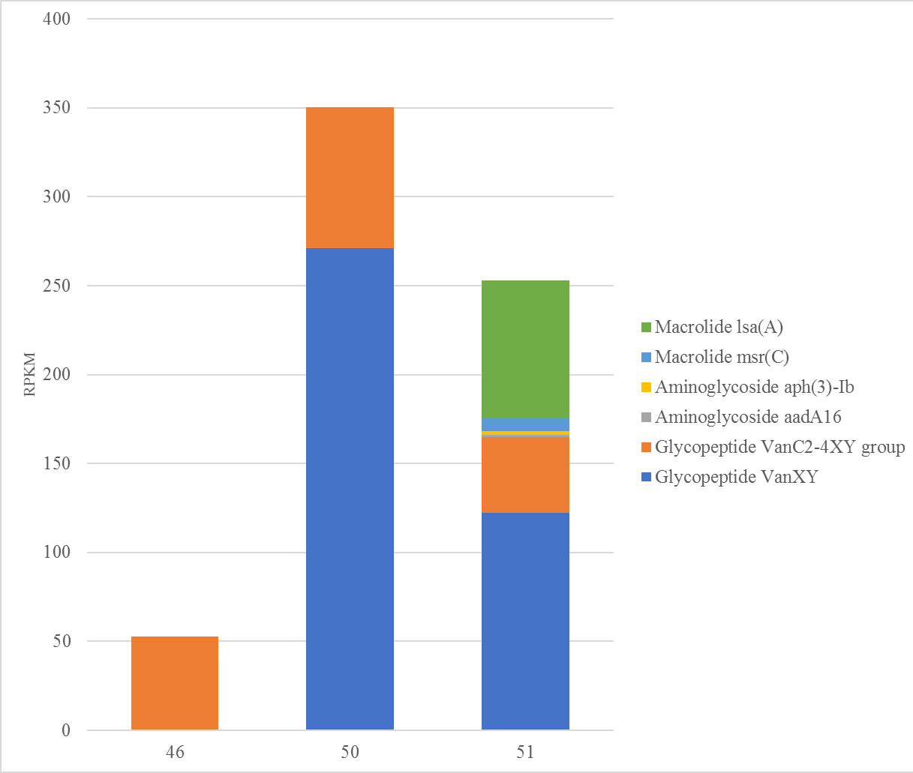
Antimicrobial Resistance Genes in Cheese Manufacturing Facility Swab Culture Enrichments
Notes:
We’ve just started to explore looking for antimicrobial resistance genes in a cheese manufacturing facility and we’ve found some evidence for the presence of macrolides, aminoglycosides and glycopeptides in 3 swabs.
(RPKM/reads per kb per million)

Slide 31
Summary
16S and Shotgun metagenomics can describe
  Microbiomes of seafood commodities
  Environmental swabs in manufacturing facilities
Genome assembly of Shotgun metagenomics
  matches with L. mono isolates cultured from environmental swabs
Proof of Principle that Metagenomics can work for detecting food pathogens
Metagenomics being used as a Culture Independent Screening Tool (CIST)
Notes:
Proof of Principle that Metagenomics can work for detecting food pathogens; however, our regulatory work still remains the cultural method of isolating a single colony and confirming that isolate.

Slide 32
Challenges
DNA extractions (chemical vs beads)
Removing DNA derived from Seafood/Plants
Distilling Mega Data
  What’s important (Artifacts/Noise vs Significance)
Expense
Identifying Important Trends
Bioinformatic pipelines
Metagenomic Tools

Slide 33

Drinking from the data fire hose

Slide 34
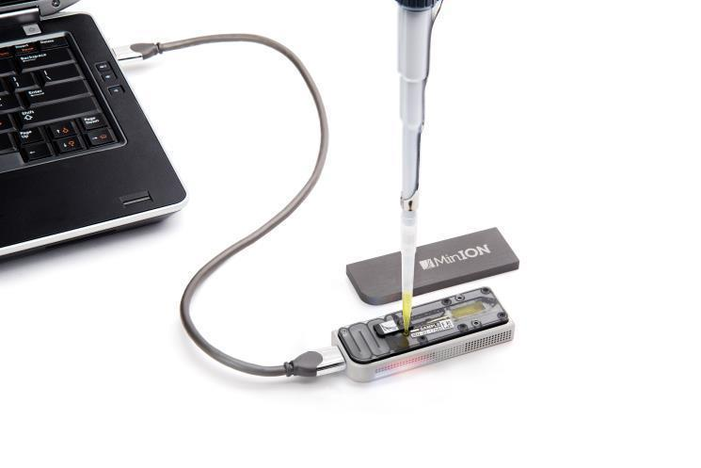
Future Directions
Explore MinION Technology
  Real Time sequencing
  Extremely Portable
    (plug into PC)
  Speed
  Ultra Long Reads
  Reusable
Speciate seafood samples (Fish Barcoding)
  Collaboration with FDA/Forensic Chemistry Center
Investigate other food types
Investigate more environmental swabs

Slide 35
Acknowledgments
Chief Scientist Program Funding
CFSAN OARSA, ORS, OAO:
Karen Jarvis
Andrea Ottesen
Christopher Grim
Susan Leonard
Ruth Timme
Padmini Ramachandran
Mark Mammel
Dave Lacher
Jamie Pettengill
Hugh Rand
CVM:
  Daniel Tadesse
  Errol Strain
Northeast Food and Feed Laboratory (ORA):
Brandon Kocurek (ORISE)
Paul Morin
Yelena Karaseva
Kent Hermann
John Leazer
NFFL Microbiologists
ORA/ORS/ORCET

Slide 36
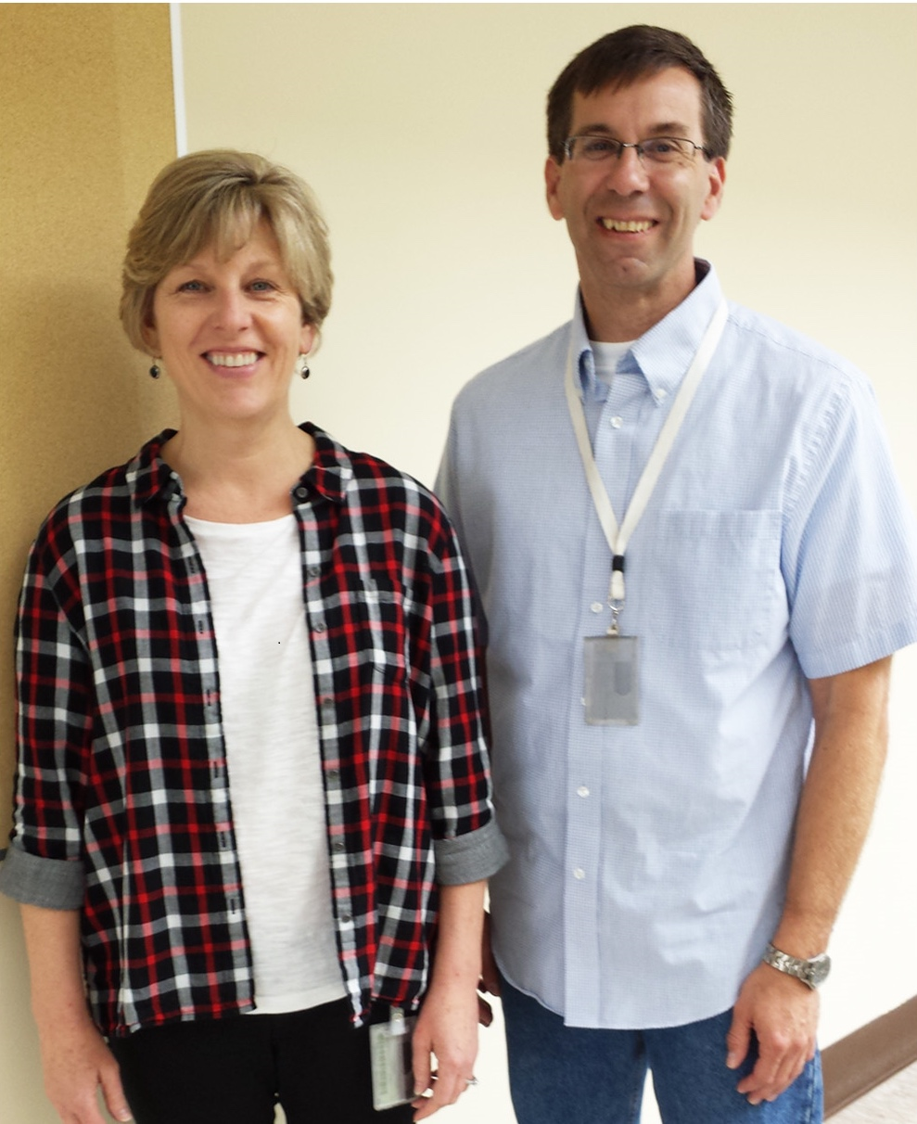
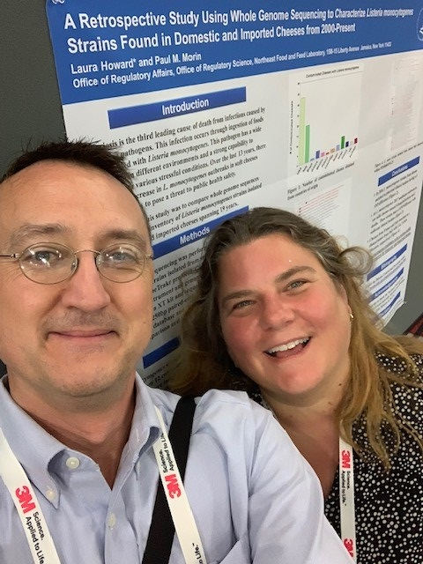
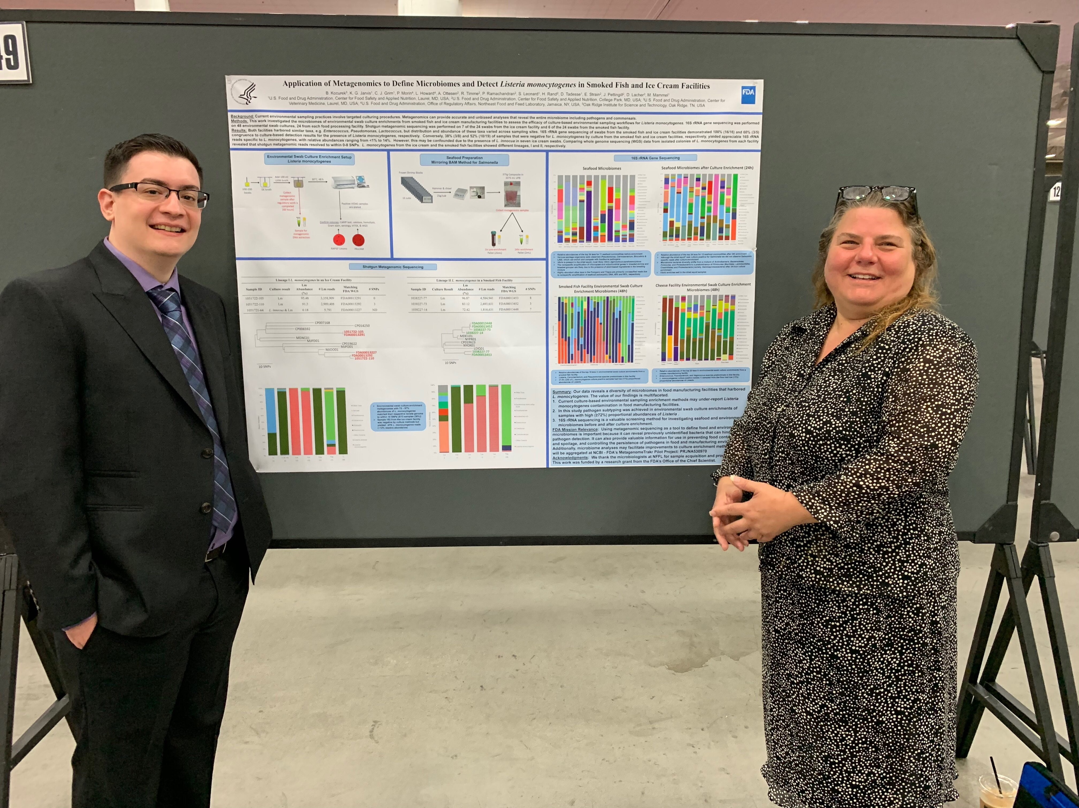

Slide 37
Join Us
Twitter Account: @metagenometrakr
Publicly available data at NCBI
  Bioproject PRJNA530970
Contact Us
  Laura.howard@fda.hhs.gov
Thank you!

