Slide 1
Data Review and Reporting in
ISO/IEC 17025:2005
Section 5.10 with guest
appearances from 4.7.2 & 5.4.7

Slide 2
What does the standard say?
5.10.1 - basic guidance for reporting values
  Results of each test shall be reported
    accurately
    clearly
    unambiguously and objectively
    in accordance with any specific instructions in the test or calibration methods.
  Reports shall include
    all the information requested by the customer
    necessary for the interpretation of the test or calibration results.
  Internal customers (or when there is a written agreement with customer) results may be reported in a simplified way.

Slide 3

5.10.1 - Your Customer
Customer agreements can be used to make the report as simple as possible.
Information may be necessary, but not required for reporting.
Section 4.4 (Review of Requests, Tenders, and Contracts) clarifies reporting beforehand
  Measurement Uncertainty
  Reports with subcontractors

Slide 4
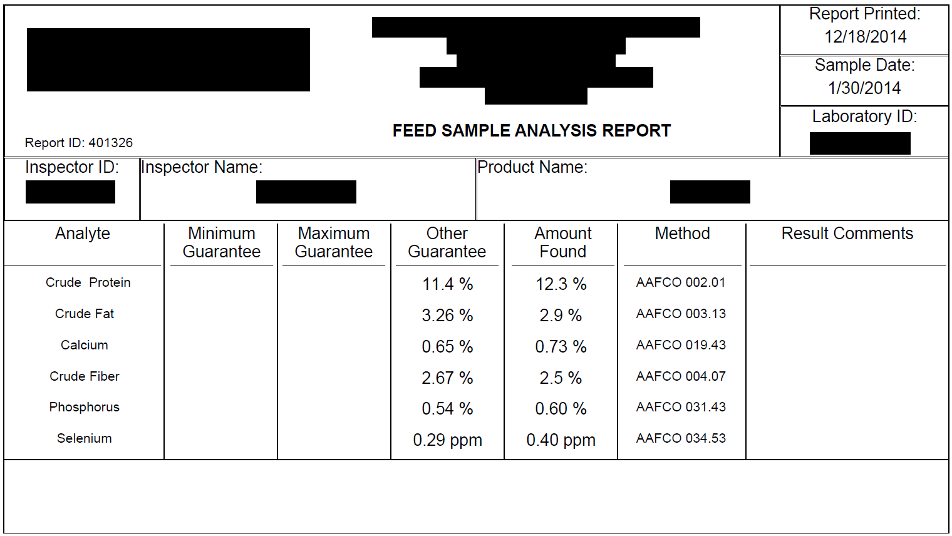
5.10.2 Reporting Requirements
Customer name/address
ABC Feed Corporation
123 Main Street
Hometown, OK 12345
Feed First Laboratory
126 Animal Way
Best Friend City,
Oklahoma, NB 12345
Name/Address of Lab
Unique identifier
of test report
16C01235
456
D. Martyn
ACE Rabbit Feed
Report Title
Unambiguous Identification
Method Identification
Test results/Units of measurement

Slide 5
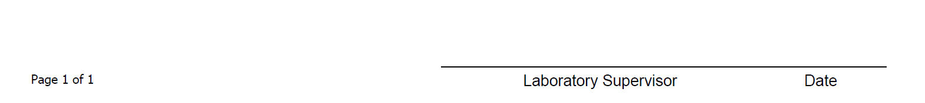
Reporting Requirements
Page Identificaton
Authorizing Signature

Slide 6
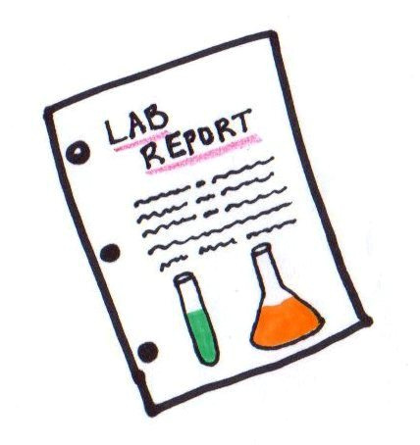
5.10.2 – Minimum Reporting
e) Methods require identification.
f) Descriptions of items can be a simple
  “acceptable” condition unless required to go into
  detail per 5.10.5, Opinions and Interpretations.
j) Electronic / mechanized signatures are acceptable if protected from unauthorized use and is identifiable. The signature must be traceable!
  There is no specified format.

Slide 7
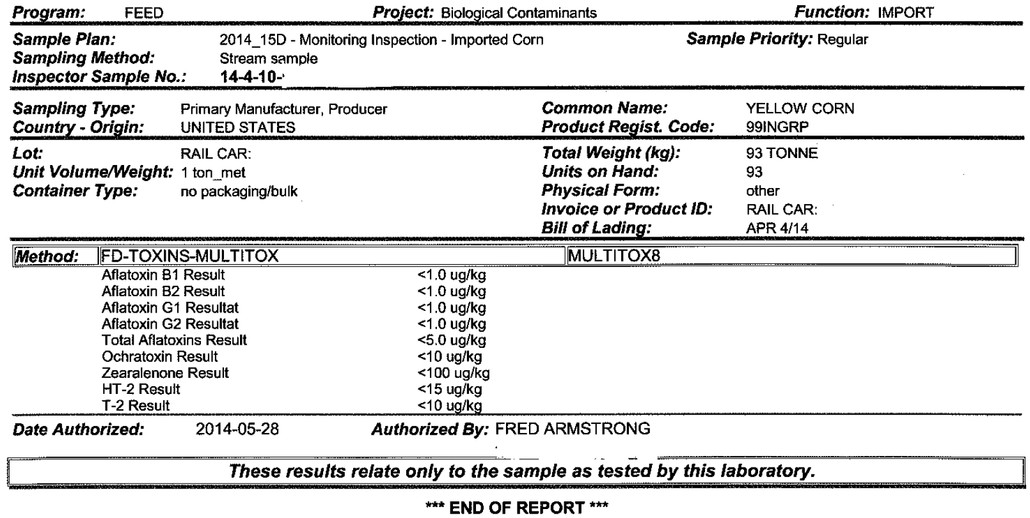
5.10.2 – Minimum Reporting
k) Where relevant, a statement to the effect that the results relate only to the items tested or calibrated.

Slide 8

5.10.3 – “where necessary”
for the interpretation of test results
  Deviations, additions or exclusions from test method
  Information of specific test conditions (environmental conditions)
  Statement on compliance/non-compliance with requirements and/or specifications
  Statement on estimated uncertainty
  Opinions and Interpretations
  Program-specific requirements

Slide 9

5.10.3 – “where necessary” -sampling
for the interpretation of test results for reports containing results of sampling
  Date of sampling
  Unambiguous identification
  Location of sampling
  Reference to sampling plan
  Environmental conditions that may effect interpretation
  Sampling method and/or deviations/additions or exclusions

Slide 10
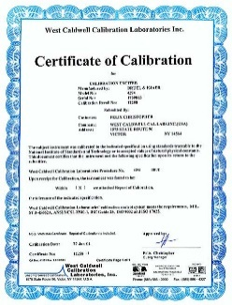
5.10.4 – Calibration certificates
Does this section apply to our Laboratory?
YES! Reporting is not just for outgoing reports from us, but for reports coming in, especially calibration reports!
Important step in protecting ISO/IEC 17025 Accreditation is to scrutinizing calibration reports for calibrations performed for us.
  Calibration reports need have required information. Our laboratory is customer
  for the calibration laboratories!

Slide 11
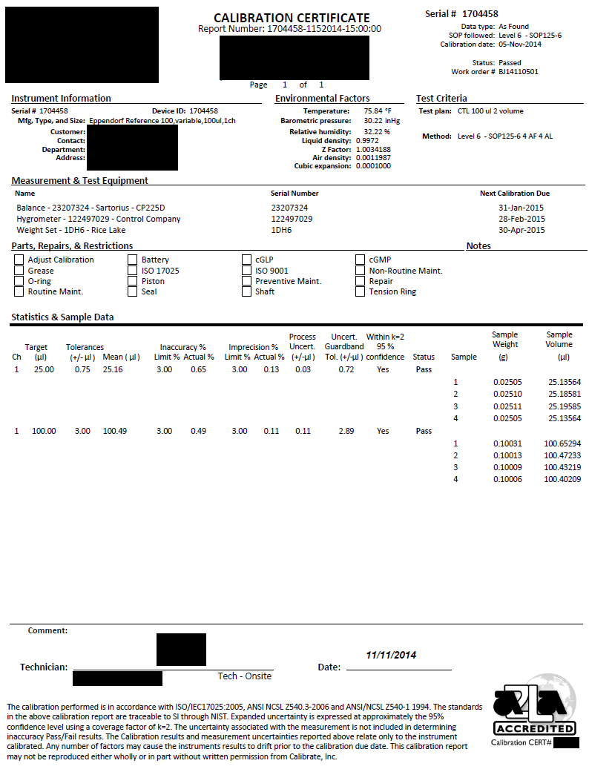
5.10.4.4 A calibration certificate ... shall not contain any recommendation on the calibration interval except where this has been agreed with the customer. This requirement may be superseded by legal regulations.

Slide 12

5.10.5 Opinions & Interpretations
Not to be confused with tests requiring qualitative RESULTS (e.g. feed microscopy / filth)
Opinions and Interpretations are strictly controlled if they are included in the report itself.
Opinions and interpretations may be given informally through e-mail, non-reporting letters, and according to NOTE 3 of ISO/IEC 17025, should be documented.

Slide 13

5.10.5 Opinions & Interpretations
In order for a report with opinions and interpretations to be included in an accredited report, the basis of how opinions and interpretations have been made must be documented.
Opinions clearly marked
as such on test report.

Slide 14

5.10.6 - Subcontractors
Customer --> Laboratory --> Subcontracting
Results reported by subcontracting laboratories shall be recorded in writing or electronically by the laboratory
Must be clearly identified as coming from the subcontractor laboratory
for the customer to see

Slide 15

5.10.7 – Electronic Reports
Should meet requirements of section 5.4.7, Control of Data
Reporting can be simplified according to a contract, memorandum of understanding, or similar document
  e.g. automatic database dumping into agency's electronic database

Slide 16


5.10.8 – Reporting Formats
Reports formatted in a way to minimize the possibility of misunderstanding or misuse.

Slide 17
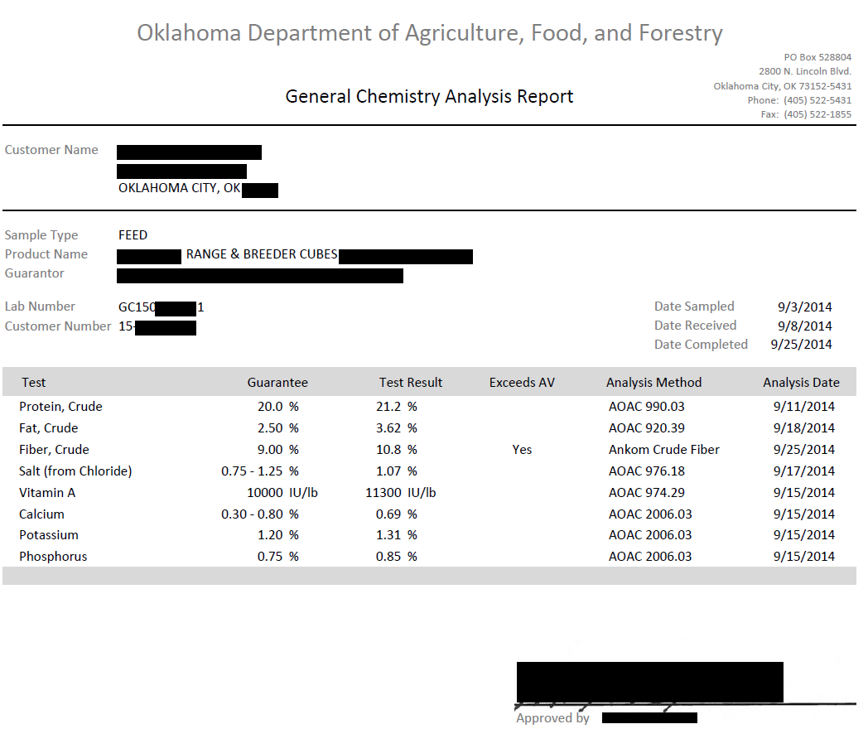
5.10.8 – Reporting Formats

Slide 18

5.10.9 – Amendments
Differentiating between an amendment (also a re-issue) and a new report
  Typos? Mistakes? Complaints?
  Request from customer to retest a sample?
  Reissuing a Report?

Slide 19

5.10.9 – Amendments
Amendments made only in the form of a further document, or data transfer
Includes a statement similar to:
  “Supplement to Test Report, serial number (or otherwise identified)”
Amendments meet all of the reporting requirements

Slide 20
5.10.9 – Amendments
If new test reports need to be issued, they shall
  Be uniquely identified
  Contain reference to original report

Slide 21

4.7.2 - Feedback
Customer can provide feedback on reporting and how it can be improved.

Slide 22

Data Review – section 5.4.7
Calculations/data transfers subject to checks in a systematic manner.
Quality management system procedures document how this is done

Slide 23
Records of reviews
4.13.2.1
The records shall include the identity of personnel responsible for the sampling, performance of each test and/or calibration and checking of results.

Slide 24
In Conclusion: Reporting
ISO/IEC 17025 has specific requirements for generating reports
  Objective
  Meets needs of customer
  Includes additional information required needed for interpretation of results
  Easy to understand/follow
Reports may be simplified if reporting to an internal customer or if there is an written agreement with customer in place.

Slide 25
References
ISO/IEC 17025:2005 General requirements for the competence of testing and calibration laboratories
https://www.iso.org/standard/39883.html

