Slide 1
NCBI Pathogen Detection Updates: Neighbors, Notifications, Custom labels, and AMR
Arjun Prasad, PhD

Slide 2
Lots of new isolates
> 435,000 isolates in total
> 220,000 Salmonella
30 taxa
First fungal pathogen Candida auris

Slide 3
NCBI Pathogen Detection Goals
Answer two questions:
1. Are isolates clonally related?
2. What is the antimicrobial resistance gene repertoire of an isolate?

Slide 4
NCBI Pathogen Detection Goals
Answer two questions:
1. Are isolates clonally related?
2. What is the antimicrobial resistance gene repertoire of an isolate?
3. What are the virulence and stress-resistance genes of an isolate?

Slide 5
Pathogen Detection Analysis Pipeline
WGS reads from SRA
Assemblies from GenBank
Assemble, quality filter
< 60 min.
for Rapid Reports
Cluster using wgMLST/Rapid Reports with wgMLST
< 36 hr.
200K Salmonella
SNP phylogenetic analysis - each cluster
https://www.ncbi.nlm.nih.gov/pathogens/

Slide 6
Updates: 1. Are isolates clonally related?
Pipeline updates for speed
GenBank submissions of our assemblies
  ~180,000 assemblies so far
Help pages
New features in the browser
  SNP neighbors https://go.usa.gov/xVQHE
  Email alerts https://go.usa.gov/xVQHn
    Isolate browser queries
    Watched isolates
  Custom labels on trees https://go.usa.gov/xVQHy

Slide 7
Help pages
https://www.ncbi.nlm.nih.gov/pathogens
https://www.ncbi.nlm.nih.gov/pathogens/pathogens_help/

Slide 8
New Browser Features
Email alerts on queries
  https://www.ncbi.nlm.nih.gov/pathogens/isolates#/search/papaya
  Must be logged in
Watched Isolates email alerts
  https://www.ncbi.nlm.nih.gov/Structure/tree/#!/tree/Salmonella/PDG000000002.1552/PDS000031858.5?term=papaya
Custom labels on trees

Slide 9
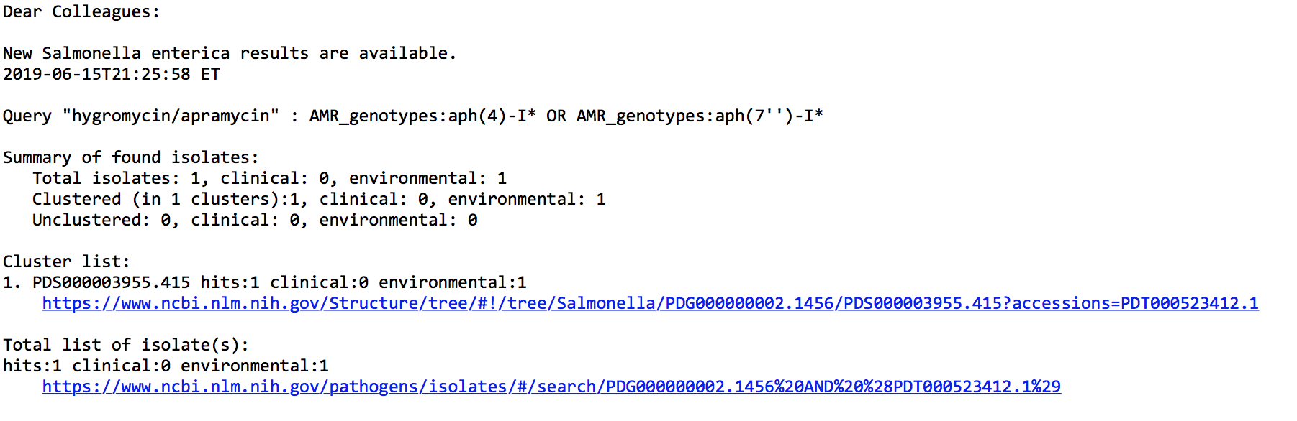
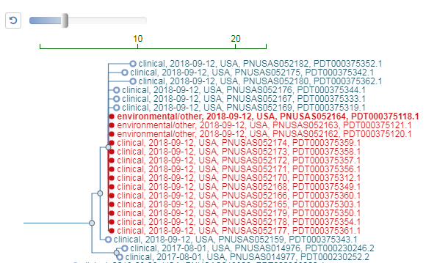
Automated Alerts: Email Notifications
Requires MyNCBI login
- email includes links highlighting new isolates
within SNP trees when opened in browser
https://go.usa.gov/xmHFU

Slide 10
Updates 2: What is the antimicrobial gene repertoire of an isolate?
New Reference Gene Catalog for easier access to the reference genes in our database https://www.ncbi.nlm.nih.gov/pathogens/isolates#/refgene/
New version of AMRFinder now called AMRFinderPlus 3.1 https://github.com/ncbi/amr/wiki PMID: 31427293
  AMR point mutations for Salmonella, E. coli, and Campylobacter
  Curated functional information for AMR genes
  Virulence factors, heat, biocide, and metal-resistance
  Combined nucleotide and protein search
  Bioconda integration for easier installation

Slide 11
Acknowledgements
Richa Agarwala
Victor Ananiev
Azat Badretdin
Slava Brover
Joshua Cherry
Jinna Choi
Vyacheslav Chetvernin
Robert Cohen
Michael DiCuccio
Boris Fedorov
Mike Feldgarden
Lewis Geer
Renata Geer
Dan Haft
Lianyi Han
Avi Kimchi
Michel Kimelman
William Klimke
Alex Kotliarov
Valerii Lashmanov
Aleksandr Morgulis
Eyal Moses
Chris O'Sullivan
Arjun Prasad
Edward Rice
Kirill Rotmistrovskyy
Alejandro A. Schaffer
Nadya Serova
Stephen Sherry
Sergey Shiryev
Martin Shumway
Oleg Shutov
Douglas Slotta
Alexandre Souvorov
Tatiana Tatusova
Francoise Thibaud-Nissen
Igor Tolstoy
Lukas Wagner
Hlavina Wratko
Chunlin Xiao
Alexander Zasypkin
Eugene Yaschenko
Minghang Zhang
David Lipman
James Ostell
Kim Pruitt
CDC
FDA/CFSAN
GenFS
USDA-FSIS
PHE/FERA
NIHGRI
NIAID
WRAIR
Broad
Wadsworth/MDH
Vendors: PacBio, Illumina, Roche
pd-help@ncbi.nlm.nih.gov
This research was supported by the Intramural Research Program of the NIH, National Library of Medicine. http://www.ncbi.nlm.nih.gov
National Center for Biotechnology Information – National Library of Medicine – Bethesda MD 20892 USA

Slide 12
Lots of new isolates
> 435,000 isolates in total
> 220,000 Salmonella
30 taxa
What problems have you had working with large scale microbial sequence data?
Please meet us in the back of the room after the talk
pd-help@ncbi.nlm.nih.gov

Slide 13
URLs used for live demos
https://www.ncbi.nlm.nih.gov/pathogens
https://www.ncbi.nlm.nih.gov/pathogens/isolates#/search/papaya
Log In!
https://www.ncbi.nlm.nih.gov/Structure/tree/#!/tree/Salmonella/PDG000000002.1552/PDS000031858.5
https://www.ncbi.nlm.nih.gov/pathogens/isolates#/refgene/

