Slide 1
Independent Submission
Strategy from GenomeTrakr
Sept 17, 2019
Ruth Timme, PhD
GenomeTrakr Program Lead
FDA Center for Food Safety and Applied Nutrition
ruth.timme@fda.hhs.gov
240 381-6974
Notes:
GT has become a global WGS network for foodborne pathogen traceback.

Slide 2
FDA’s GenomeTrakr
Distributed network of laboratories sequencing foodborne pathogens from food and environmental sources.
GenomeTrakr submits data on behalf of the 49 following labs:
  13 U.S. FDA Labs
  13 PulseNet Labs
  12 University Labs
  6 U.S. Department of Agriculture Labs
  3 Private Labs
  1 International Lab
  1 U.S. Hospital Lab
NCBI’s Pathogen Detection portal: Public database where food/env GenomeTrakr isolates join clinical isolates sequenced by PulseNet (PHE + others).
This is the primary data repository for FDA’s GenomeTrakr network
7 Vet-LIRN labs
7 NARMS labs
Notes:
Around 42 labs The network has experienced growth since the beginning and currently it is integrated by 13 federal labs, 11 PulseNet labs, 5 U.S. Department of Agriculture Labs, 7, University Labs, 3 Private Labs, 2 International Labs (Argentina, Mexico), 1 U.S. Hospital Lab

Slide 3
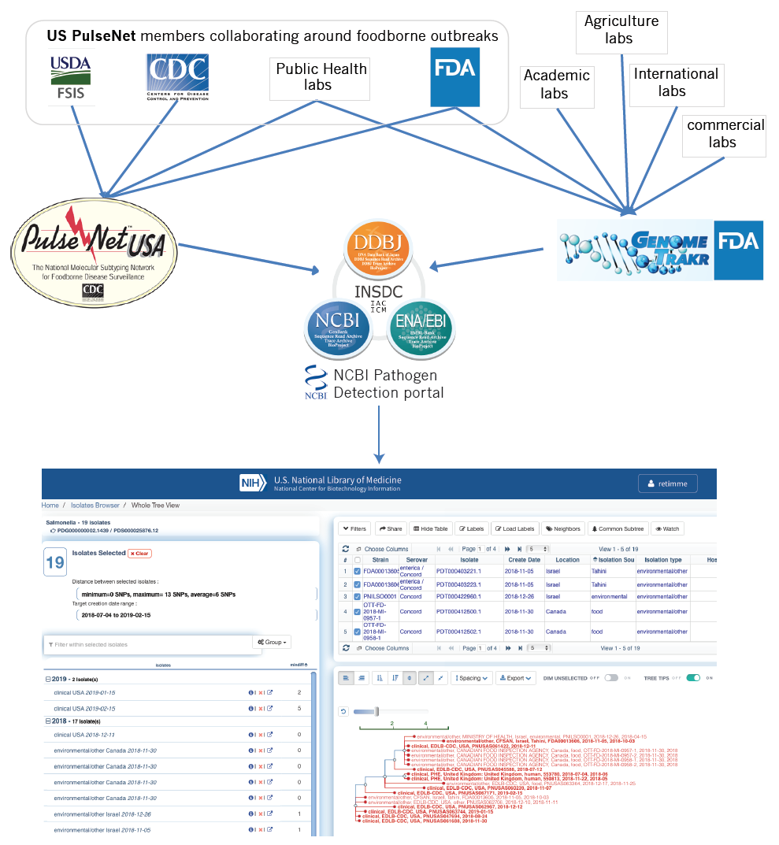

Slide 4
Direct upload to NCBI
Current model: FDA-CFSAN brokers about ~1200 submissions per month and curates over 90K public records.
Goal: All non-FDA labs will submit directly to NCBI by fall 2020.
  Summer 2019: SOP for submission through BioNumerics 7.6 (11 PulseNet labs)
  Sept 13th, 2019: Draft release of “NCBI submission best practices for microbial pathogen surveillance”, with APHL.
Result: Remove FDA-CFSAN as the broker, enabling independence of contributing labs and freeing up resources at CFSAN for improving the database.

Slide 5
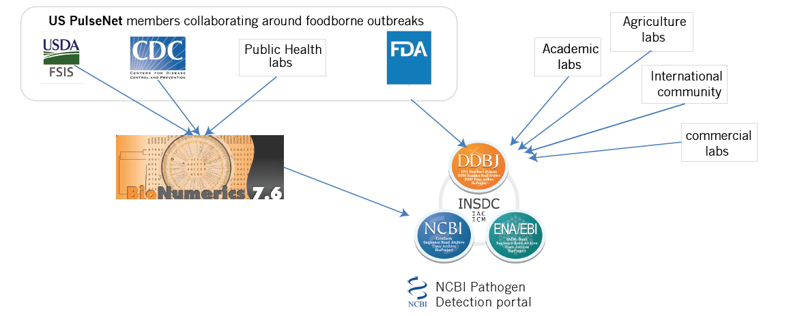
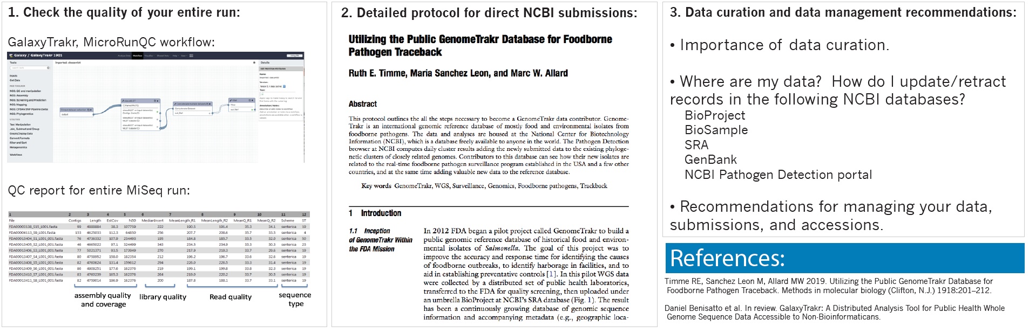
Direct upload model:
APHL Guidance Document – posted on the Redmine site:

Slide 6
NCBI submission best practices for microbial pathogen surveillance
Hosted and published by APHL
In review now by NCBI and PulseNet
Final version expected in Fall 2019

Slide 7
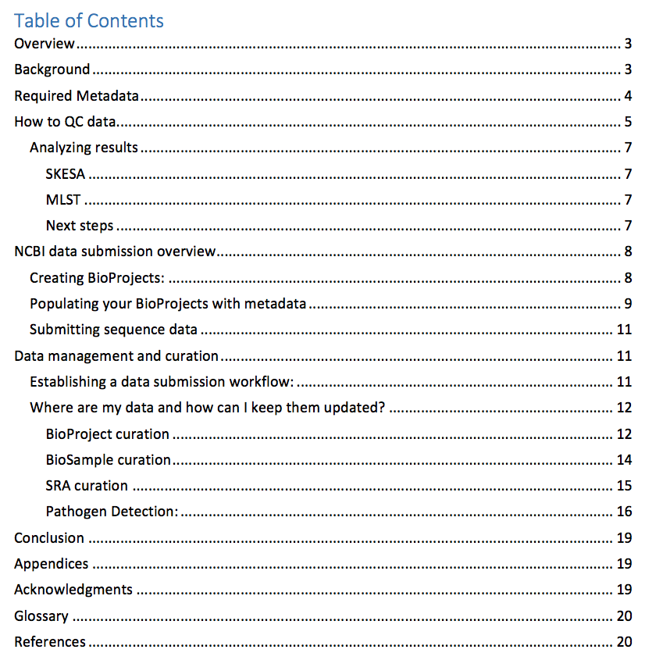
Sections of document
Developed by the GenomeTrakr team for submitting foodborne pathogen isolates collected from non-human sources. This can be used by ANY laboratory wishing to contribute to the NCBI-PD (req. listed in document)
Minimum metadata:
  laboratory name associated with the isolate
  unique strain ID,
  isolation type (human source vs. non-human source),
  collection date (year minimum)
  isolation source (e.g. type of food)
  location (Country and state if in US).

Slide 8
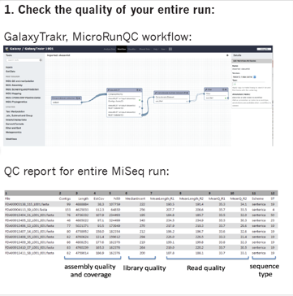
Sections of document
General guidelines on QC thresholds agreed upon by the GenFS
Announcement and SOP for the MicroRunQC workflow in GalaxyTrakr

Slide 9
Sections of document
Intro to important databases at NCBI and how they are related
Are you connected to an existing surveillance network?
Instructions on establishing a new Umbrella BioProject and linking it to the PD-pipeline.
Detailed SOP for NCBI submission (BioProjects, BioSamples, SRA submissions )

Slide 10
Sections of document
Recommended workflows for NCBI data submission
Responsibilities of contributors!
Data curation instructions for each NCBI database

Slide 11

BioNumerics 7.6 submission of GT isolates
For PulseNet labs that are members of GenomeTrakr:
Metadata template and draft SOP available for submitting GenomeTrakr isolates through BioNumerics 7.6
Labs currently testing the SOP:
  Hawaii
  VA-DCLS,
  NY Wadsworth,
  WA State DOH,
  Texas DOH,
  Minnisotta Dept. of Health
  Maryland Dept. of Health
Next testing phase
  NY-Ag
  Florida-Ag
FDA-CFSAN: gathering feedback and awaiting changes within PulseNet before asking labs to submit solely through this route.

Slide 12

GenomeTrakr goals for FY20:
Transition to independent submission for ~35 laboratories, reducing our uploads to include only FDA laboratories:
  FDA-CFSAN
  ORA field laboratories
Focus on curating and improving existing data
  adding source category fields to exiting 90K records (and develop plan for getting these fields on new submissions)
  releasing guidance on populating the “collection source” field
  identifying problematic isolates for re-sequencing
  Implementing SeqSero2 in our regulatory workflow and include a serovar name for every Salmonella submission.
Increase food/environmental sampling across the US, and abroad.
  Meeting Nov. 19 - 21, 2019
College Park, MD
Roll out new funding model in Spring 2019 (LFFM)

Slide 13

Acknowledgements
Direct submission best practices document
  Robyn Randolf (APHL)
  Errol Strain (FDA-CVM)
  Bill Wolfgang (NY Wadsworth)
  Sai Laxmi Gubbala Venkata (NY Wadsworth)
  Maria Balkey (FDA-CFSAN)
BioNumerics 7.6 GenomeTrakr submission SOP and template
  Maria Balkey (FDA-CFSAN)
  GenomeTrakr pilot labs
      @DoctorRuth
      @genometrakr

