Slide 1
Laboratory Flexible Funding Model
Project Briefing
GenomeTrakr Annual Meeting
September 18, 2019
Erin Woodom-Coleman
Donald H Burr

Slide 2
Agenda
What’s the Big Picture: Mutual Reliance
Project Background
Project Timeline
LFFM Design
Communications Strategy
Next Steps
Questions & Feedback

Slide 3

Mutual Reliance
Mutual Reliance is a seamless partnership that enables FDA and States with comparable public health systems to:
fully rely on,
coordinate with, and
leverage
one another’s work, data, and actions to achieve the public health goal of a safer national food supply.
We all benefit from Mutual Reliance by leveraging partner agencies to improve industry compliance with a goal of reducing food borne illness outbreaks and increasing public health protection in our integrated Food Safety System.

Slide 4
Mutual Reliance Benefits
Establishes a shared process for prioritizing risks and focusing scarce resources
Provides an objective and transparent process for ensuring a safe domestic food supply
Fosters close partnerships and leverages work done by competent State verified with comparable food safety systems
Reduces duplication of efforts and allows State work to count toward inspection frequency mandates
Increases speed and effectiveness of surveillance, response, and post-response efforts
Promotes consistency and information sharing of lab and inspection results
Provides framework for regulatory cooperation so that FDA and States can partner with, rely on, and leverage one another’s work to ensure the safety of food and public health protection

Slide 5
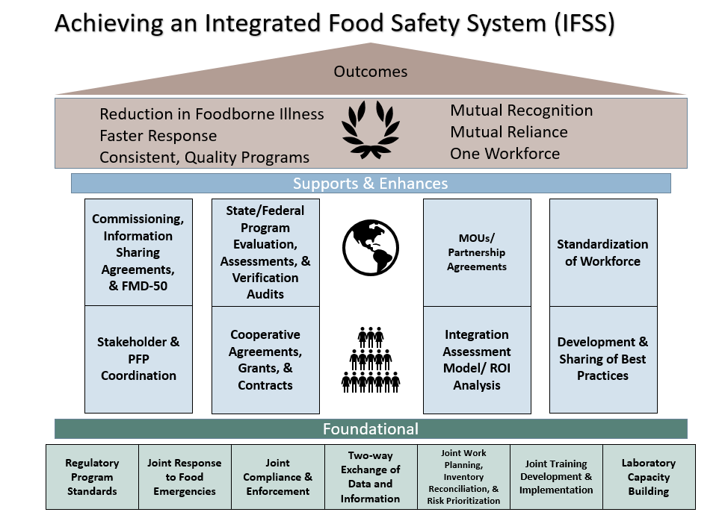

Slide 6
FDA State Lab Investment
In the last 10 years, ORA has directly awarded approximately $172M to over 60 state labs across cooperative programs and contracts.
Funding vehicles include:
  The Food Emergency Response Network (FERN);
  Whole Genome Sequencing cooperative agreements;
  Manufactured Foods Regulatory Program/ISO cooperative agreements;
  Animal Feeds Regulatory Program/ISO cooperative agreements;
  Rapid Response Team cooperative agreement-analytical support; and
  Contracts for analytical support, including Human (product and environmental testing) and Animal Food.

Slide 7
Project Goals & Deliverables
Conduct assessment of current State & FDA laboratory portfolio, including various CAPs and FERN. Completed.
Combine multiple state cooperative agreements into one funding vehicle: Laboratory Flexible Funding Model (LFFM). LFFM will ensure more effective monitoring, oversight and accountability of the funds.
FDA plans to announce this new model in Winter FY20. Funding via this model may begin in Summer 2020.
Notes:
This project begin with the lab assessment. The assessment recommendations were approved by the FDA FVM Governance Board in mid-June 2018. This presentation outlines the design and communications strategy based on the lab assessment.

Slide 8
LFFM Collaboration
LFFM Workgroup - Consists of staff across FDA:
  Office of Regulatory Affairs (ORA)
  Center for Veterinary Medicine (CVM)
  Center for Food Safety and Applied Nutrition (CFSAN)
  Office of Acquisition and Grants Services (OAGS)
LFFM Advisory Stakeholders:
  Senior FDA leadership
  State Lab Partners
  APHL
Notes:
Workgroup
CFSAN – Jamie Hughes, Marc Allard, John Callahan, Greg Diachenko, Eric Brown, Amy Barringer, Tim Croley, Karen Blickenstaff
CVM – Jenny Murphy, Linda Benjamin, Renate Reimschuessel, Pat McDermott, Emily Crarey
Advisory Committee
Paul Norris (ORS Director)
Alan Tart (OP Dep. Director)
Barbara Cassens (OP Director)
Karen Kreuzer (ORS)
Daniel Rice (ORS)
Vinetta Howard-King (OHAFO Director)
Jeff Ward (OFVM SCCG Chair)
Tracey Forfa (Dep. Director, CVM)
Steve Musser (Dep. Director, CSFAN)
Denise Toney (VA Lab)
Jason White (CT Lab)
Maria Ishida (NY Ag Lab)
Shari Shea (APHL)

Slide 9
Milestones and Progress
Milestone | Completion Date | Status
Project kick-off completed | 9/29/2017 | Complete
State lab portfolio assessment completed | 5/30/2018 | Complete
LFFM design drafted | 6/29/2018 | Complete
LFFM design approved | 9/28/2018 | Complete Approved by: ACRA – 7/20/2018 FVM Governance Board – 8/9/2018
FOA drafted | June 2019 | Complete FOA writing began in September 2018
FOA and NOITP approved & submitted to OAGs | November 2019 (target) | Reviewers and approvers are FDA Sr. Leadership
New awards made | Summer 2020 (target)

Slide 10
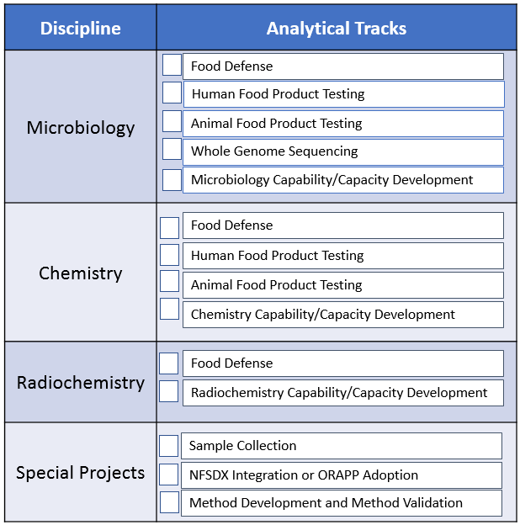
LFFM Design
A single agency can apply for as many discipline/analytical track
combinations of which they qualify.
Notes:
Structure: 3 disciplines, each with several analytical tracks:
Chemistry/Microbiology/Radiology Disciplines
Examples of Analytical Tracks
Microbiology- Food Safety/Food Defense; Human Food; Animal Food; Whole Genome Sequencing
Chemistry- Food Defense; Human Food;Animal Food
Radiology- Alpha; Beta; Gamma
A single agency can apply for as many discipline/analytical track combinations of which they qualify
Each analytical track will have:
Work area (based on CVM/CFSAN priorities)
Funding amount
Scoring criteria
The model still contains the structure of a “maintenance” and a “development” option for each discipline. However, any equipment replacement activities will need to be accomplished through the overarching maintenance and development funds to the laboratories.
Addition of a “Special Projects Track”. It is envisioned that each year, based upon FDA priorities and available funding, special FDA-directed projects would be offered. Priorities could include: sample collections, IT upgrades (increase NFSDX participation), and method development.
The LFFM is part of FDA’s Lab Strategy that will support Mutual Reliance as an outcome of a National IFSS; the Maintenance, Dev and Special Projects funding options support these goals. As mentioned over the last 6-9 months, there is no designated funding option for ISO accreditation; that being said, using grant funds for ISO accreditation would be determined on a case-by-case basis if the request is determined to be a high priority and if funds are available (this would be an exception, not the rule).

Slide 11
LFFM Design - Funding process
Labs apply for as many disciplines/analytical tracks as they are interested in and for which they qualify
  FOA: structured to incentivize labs to apply broad-based
  State labs could apply individually or in collaboration with other labs in the same state
Applications are objectively reviewed and scored
Awards are made based on determined FDA capability and capacity needs
  Selects a number of broad-based labs per discipline (X micro., X chem., X rad.) – highest scored applications
  Selects additional labs per analytical track needed beyond the capacities/capabilities of broad-based labs (e.g., X food defense, X human food and environmental sampling, etc.) – award in order of score
Notes:
A single agency can apply for as many discipline/analytical track combinations of which they qualify
Some laboratories would be applying for several analytical tracks and these would be broad-based testing laboratories.
To apply the funding more appropriately, we will not be funding laboratories at just three levels as in prior presentations (CoE, Specialty and Surge) but at a variable rate based upon the number of disciplines and analytical tracks for which the laboratory was awarded.
Variable sample loads have been incorporated into each analytical track, to provide an additional level of flexibility to smaller laboratories and/or laboratories with reduced resources. (Low/Medium/High bullets)

Slide 12
LFFM Communications Strategy
Key Messaging
  LFFM goals and design
Target Audience
  State laboratory partners
  Key national associations (APHL, AAFCO, AFDO, NASDA, etc.)
  State food emergency response groups/programs (FERN, Rapid Response Teams, Food Protection Task Force, GenomeTrakr, etc.)
Communication Vehicles
  National broadcast message
  50-state call
  Various external stakeholder and national association meetings
Timeframe
  January 2019 - January 2020

Slide 13
Next Steps
Continue developing analytical tracks, work areas and scoring criteria for the FOA, including:
  Sampling and WGS lab selection process; and ISO support.
Incorporate FDA’s sampling & testing needs, as determined in the outcome-based strategic plan, into the LFFM
  In development by a cross-center planning workgroup
  LFFM is the delivery mechanism for work completed by state laboratory partners
  Includes short and long term needs
  Separate project team will be charged with overall execution of the strategic plan
Notes:
The Strategic Planning workgroup is led by Dr. Paul Norris (Director, ORA/Office of Regulatory Science) and Erik Mettler (Assistant Commissioner, ORA/Office of Partnerships and Operational Policy).

