Slide 1

Rapid Identification of Lineage Types and Phylogenetic Relationships of Clostridium botulinum strains by Whole Genome Sequencing
Narjol Gonzalez-Escalona, Ph.D.
Research Microbiologist
Division of Microbiology
Center for Food Safety & Applied Nutrition
U.S. Food and Drug Administration

Slide 2
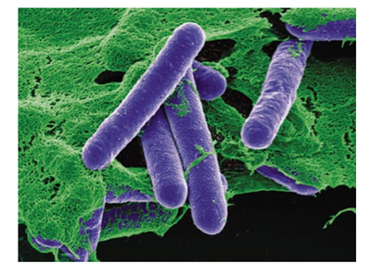
Clostridium botulinum Taxonomy
C. botulinum are genetically-diverse, gram+, rod-shaped bacteria
Taxonomically mischaracterized
C. botulinum can be divided into 4 different groups (I - IV)
-16S rDNA sequences
-AFLP
-Metabolic profiles
Group I are proteolytic and produce BoNTs type A, B, and F
Group II are non-proteolytic and produce BoNT types B, E, and F
Group III produces BoNT types C and D
Group IV produces BoNT G

Slide 3
C. Botulinum Genomics
C. botulinum specie phylogeny
Gonzalez-Escalona et al, Appl. Environ. Microbiol 2014

Slide 4
WGS NGS analysis C. Botulinum Group I
Gonzalez-Escalona et al, Appl. Environ. Microbiol 2014

Slide 5
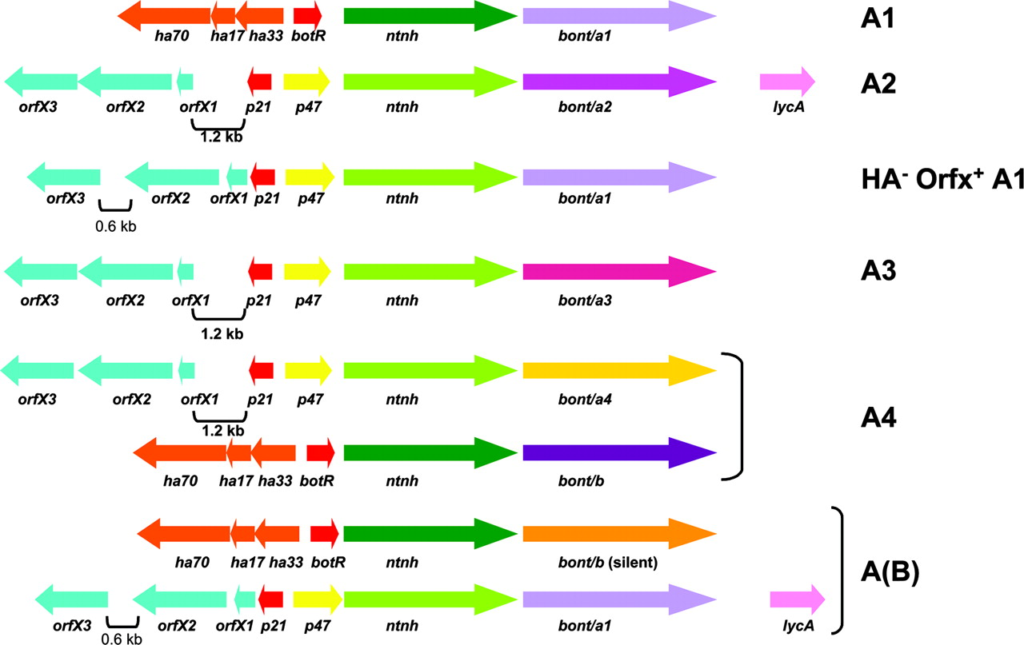
BoNT cluster arrangements C. botulinum
Genes responsible for BoNT production are located within a neurotoxin cluster.
BoNT cluster gene arrangements:
I) One conformation contains hemagglutinin genes (ha17, ha33, and ha70)
II) The other contains orfX genes which have unknown function (orfX1, orfX2, and orfX3)
Jacobson M J et al. Appl. Environ. Microbiol. 2008

Slide 6
Objective
To test WGS and our internal workflow for rapid ID of unknown C. botulinum strains:
Sequence Type (ST)?
C. botulinum group?
If group I, which Lineage?
Determine BoNT type, location, and cluster arrangements.
Gonzalez-Escalona N. et al. in preparation

Slide 7
Sequence Type (ST)?
And C. botulinum group?
Reference ID | Isolate | Source | year | Contigs | Genome size (bp) | Coverage (X)
CFSAN034197 | CDC-12/CDC1930 | Clinical | 2008* | 305 | 4,031,392 | 92
CFSAN034198 | CDC13/CDC51348 | Clinical | 2008* | 155 | 3,933,326 | 109
CFSAN034199 | CDC14/CDC00032 | Clinical | 2008* | 353 | 4,261,100 | 103
CFSAN034200 | CDC16/CDC51232 | Clinical | 2008* | 149 | 4,128,779 | 133
CFSAN034201 | 8G-F | Environmental | 1997 | 660 | 3,873,419 | 59
CFSAN034202 | 83-F | Environmental | 1996 | 187 | 3,934,497 | 144
CFSAN034886 | Langeland F, F-1 | Environmental | 1997 | 443 | 3,902,371 | 73
CFSAN034887 | PC-F | Environmental | 1972 | 256 | 3,929,156 | 125
CFSAN034888 | 4V11-F | Environmental | 1997 | 151 | 3,963,208 | 127
CFSAN034889 | 4VI-F(4YRC) | Environmental | 1997 | 197 | 3,948,022 | 106
CFSAN034890 | 610-F | Environmental | 1996 | 194 | 3,831,633 | 116
CFSAN034891 | 202-F | Environmental | 1996 | 323 | 3,817,081 | 52
CFSAN034203 | 205-F | Environmental | 1996 | 369 | 3,781,283 | 72
13 unknown C. botulinum strains FDA collection were sequenced with MiSeq (Illumina)
Gonzalez-Escalona N. et al. in preparation

Slide 8
A new sequence type (ST88) was detected among group I
Reference ID | ST | BoNT Serotype | botR | ha- Cluster | Orf-X Cluster | p47
CFSAN034197 | 6 | A1,B | + | +(B*) | +(A) | +
CFSAN034198 | 10 | A1,b5 | + | +(B*) | +(A) | +
CFSAN034199 | 22 | F(x2), A2 | + | - | + | +
CFSAN034200 | 7 | a4,B5 | + | +(B) | +(A) | +
CFSAN034201 | 88 | F | + | - | + | +
CFSAN034202 | 4 | A1,b5 | + | +(A) | +(B*) | +
CFSAN034886 | 88 | F | + | - | + | +
CFSAN034887 | 88 | F | + | - | + | +
CFSAN034888 | 88 | F | + | - | + | +
CFSAN034889 | 88 | F | + | - | + | +
CFSAN034203 | Group II | F | + | - | + | +
CFSAN034890 | Group II | F | + | - | + | +
CFSAN034891 | Group II | F | + | - | + | +
Group I
Group II
Gonzalez-Escalona N. et al. in preparation
Notes:
Five of the group I strains belonged to known STs (6, 10, 22, 7, and 4), while the other 5 strains represented to belong to a new ST (ST88). Altogether, these 10 strains of MLST-Group I, belonged to 6 different STs (Table. 2).
Five ST88 strains had a novel aroE allele (aroE34), differing by 3 SNPs from aroE19, and otherwise have an identical profile to Langeland strain type F and carried the type BoNT F cluster.
The 3 strains that showed fldb^{-ive} in the PCR assay also exhibited highest similarity with the members of group II (e.g. C. botulinum E3 str. Alaska E43) through BLAST genome analysis.
Notably the two-component signal transduction system encoding response regulator (cbo0786) and sensor histidine kinase (cbo0787) in Group II strains were not readily detectable. This possibly indicates that the toxin synthesis in group II may be in response towards different environmental stimuli than that of group I strains, or controlled by unknown regulatory systems.

Slide 9
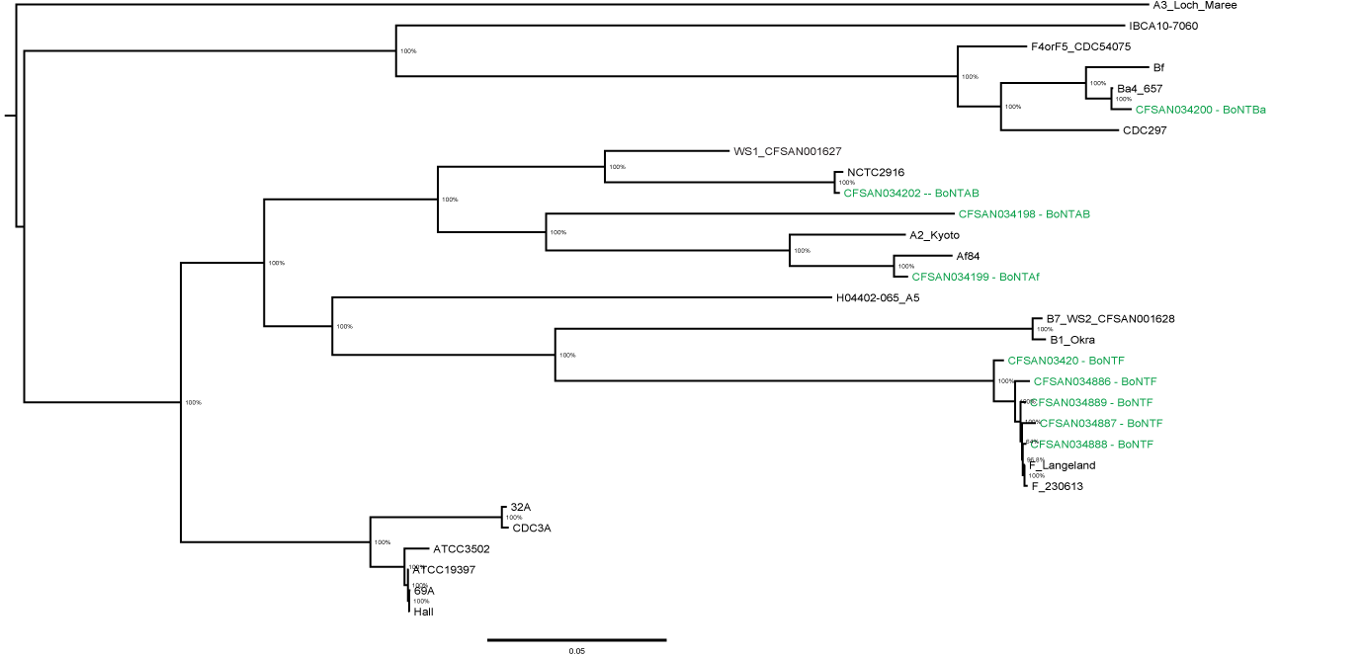
If group I, which Lineage?
ST7
2
ST4
ST10
3
ST22
ST88
4
Maximum likelihood phylogeny C. botulinum Group I
(133,330 bp core SNP matrix)
Gonzalez-Escalona N. et al. in preparation
Notes:
Strains in green are the sequenced new genomes
SNP analysis (Figure. 2) of the 10 strains indicated that these strains belonged to C. botulinum group I lineage, with the majority of the strains (5) belonging to lineage 3 (Gonzalez-Escalona et al, 2014), and matched closely with strain 230613 and Langeland, both BoNTF strains. A total of 133,330 SNPs were identified for this dataset.

Slide 10
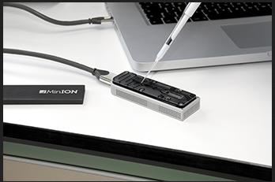
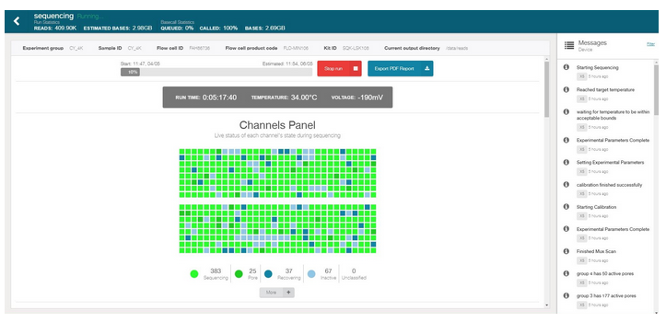
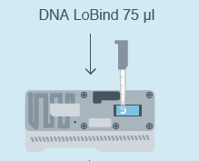
Determine BoNT type, location, and cluster arrangements.
Nanopore sequencing -> hybrid assembly with MiSeq data
RAD004 rapid sequencing kit workflow
DNA (400 ng)
1 ul FRA
Incubate 30C 1 min, then 80C 1 min
1 ul RAP
Two bivalent strains were selected:
83F
CDC51232
Incubate 5 min RT
34 ul SQB, 25.5 ul LB, 4.5 ul NFW
Library ready for loading into flow cell
Sequencing starts
Gonzalez-Escalona et al. 2018. Microb. Res. Announ.
Gonzalez-Escalona and Sharma. Submitted

Slide 11
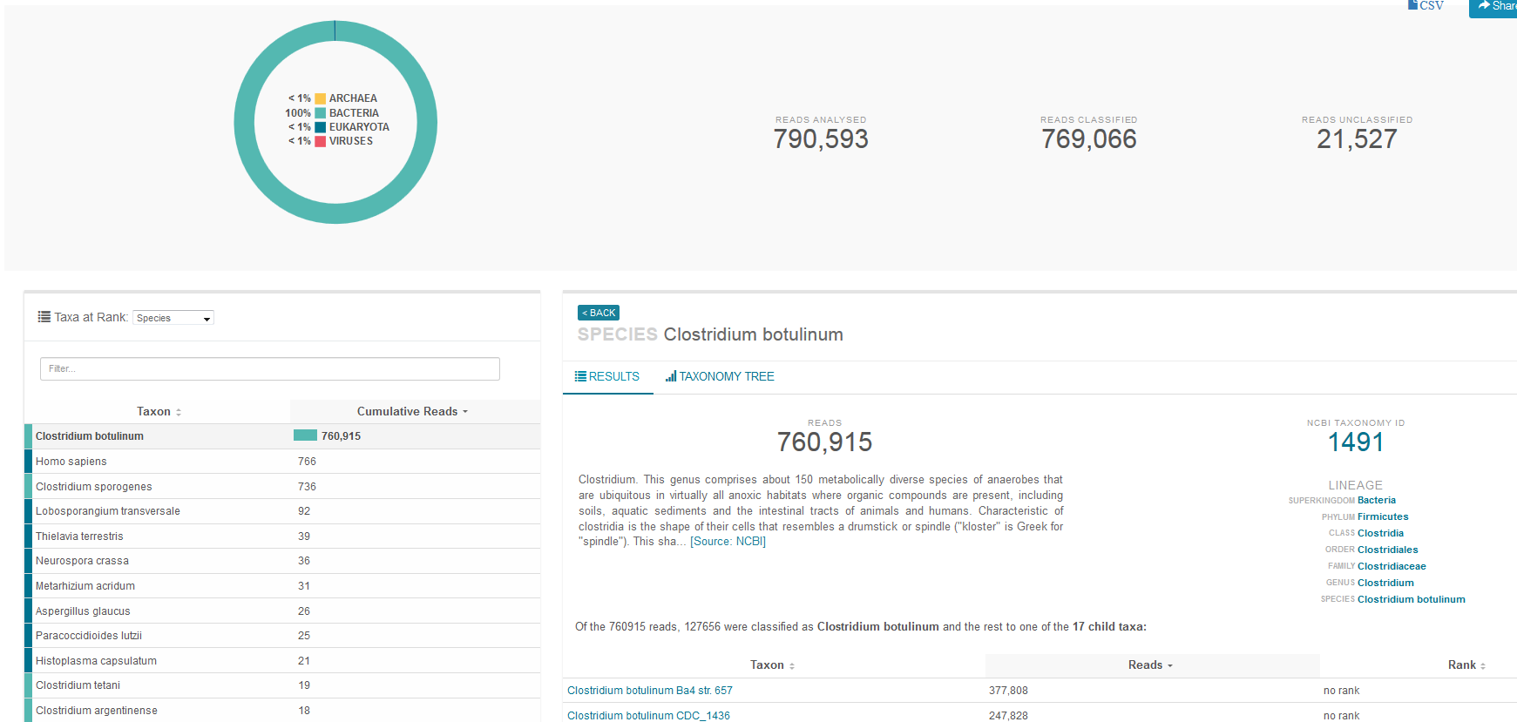
WIMP –what’s in my pot
CDC51232
Gonzalez-Escalona et al. 2018. Microb. Res. Announ.
Gonzalez-Escalona and Sharma. Submitted

Slide 12
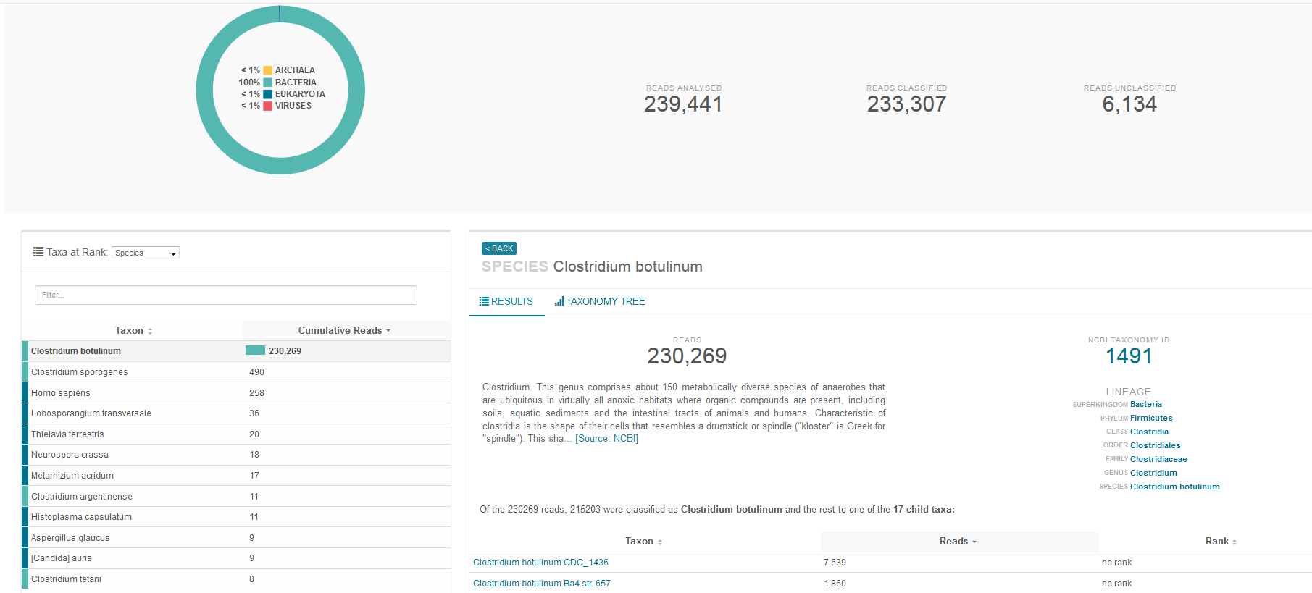
WIMP –what’s in my pot
83F
Gonzalez-Escalona et al. 2018. Microb. Res. Announ.
Gonzalez-Escalona N. and Sharma. Submitted

Slide 13
Determine BoNT type, location, and cluster arrangements.
chromosome
plasmid
Gonzalez-Escalona et al. 2018. Microb. Res. Announ.
Gonzalez-Escalona and Sharma. Submitted

Slide 14
Conclusions
Application of WGS allowed for rapid differentiation between C. botulinum group I and group II strains (ST).
WGS allowed for fast phylogenetic placement of new C. botulinum genomes with their closest relative (lineage).
Provided the ability to investigate neurotoxin complex types, cluster arrangements and regulatory genes.
This type of analysis will become routine in the near future due to the reduction in cost for sequencing, and will allow our ability for source tracking the contamination and faster outbreak response.

Slide 15
Acknowledgements
Collaborators:
Dr. Shashi Sharma,
Dr. Naga Thirunavukkarasu
Traviz Wentz
Dr. D.R. Hodge,
Thomas Hammack
FDA/CFSAN-Director of Scientific Operations
Dr. Steven Musser
Office of Regulatory Science - CFSAN
Dr. Vincent Kelly Bunning (Director)
Dr. John J. Callahan (Assistant Director)
Division of Microbiology- CFSAN
Dr. Eric W. Brown (Director)
Dr. Sandra Tallent (Branch Chief MMSB)

Slide 16


Slide 17
