Slide 1
Cyclospora cayetanensis Genomics:
Towards Genomic Typing Using Mitochondria Genomes
Hediye Nese Cinar
US Food and Drug Administration (FDA)
Center for Food Safety and Applied Nutrition
Notes:
Cyclospora cayetanensis is a major food related public health problem in the US. For prevention and management of Cyclospora outbreaks, FDA works on developing tools for molecular detection and subtyping. Today I will present our research on Cyclospora cayetanensis genomics focusing on mitochondria genome sequencing as a genomic typing tool.

Slide 2
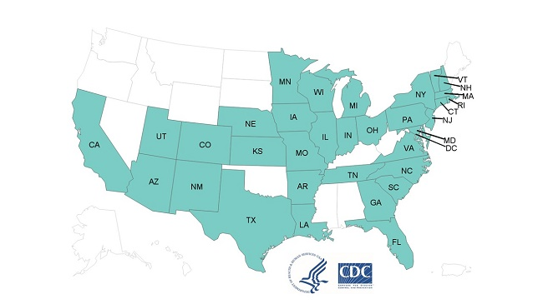
Cyclospora cayetanensis causes an intestinal illness called cyclosporiasis
Since the mid-1990s cyclosporiasis has been linked to fresh produce
2019 outbreak map from CDC
 | 2013 | 2014 | 2015 | 2016 | 2017 | 2018 | 2019*
Case count | 631 | 304 | 546 | 384 | 1065 | 2299 | 1696
States | 25 | 19 | 31 | 25 | 40 | 33 | 35
Deaths | 0 | 0 | 0 | 0 | 0 | 0 | 0
Hospitalizations | 49 | 7 | 21 | 13 | 52 | 160 | 92
* Data are current as of 8/28/2019
Notes:
Cyclospora cayetanensis causes a foodborne intestinal illness called cyclosporiasis. Since mid 1990s cyclosporiasis linked to imported fresh produce. Here you see 2017 outbreak map involving 40 states. We started seeing larger outbreaks since 2013. 2018 outbreak was the largest Cyclospora outbreak in the US.

Slide 3
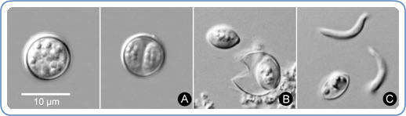
C. cayetanensis under the scope
Oocysts are the only accessible life form for research
currently no in vivo or in vitro culture method available
Unsporulated oocyst
Sporulated oocyst [infective form]
Ruptured oocyst with two sporocysts
Sporozoites
and a sporocyst
Credit: CDC/DPDM
Notes:
Oocycts are the only life form present in the environment, and the only accessible life form for research. Currently no in vivo or in vitro culture method available. Here we see microscopic images of unsporulated and sporulated oocysts. Sporulated oocyst contains two sporocysts. Each sporocyst contains two sporozoids.

Slide 4

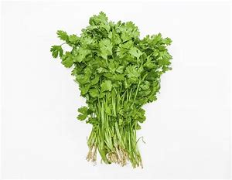
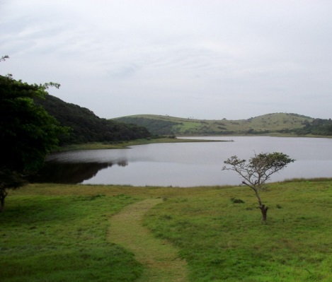
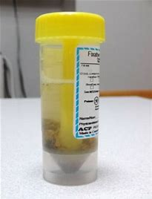

Why genomics?
patient #1
patient #2
food
water
C. cayetanensis
C. cayetanensis
C. cayetanensis
C. cayetanensis
We need subtyping methods to determine relationship between clinical, food, and environmental isolates
Notes:
We have methods to detect Cyclospora cayetanensis in patient samples, food samples and water samples. But to solve outbreaks we need to determine relationship between these isolates. For this we need subtyping methods. Currently we are relying only on epidemiological data to link clinical cases with the source. This way only one third of the cases could be linked to specific food exposures.

Slide 5



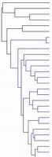


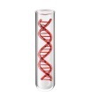

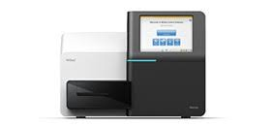
Genomic Epidemiology
Cluster 1
Cluster 2
regulatory actions: import alerts, recalls etc.
Cluster 3
Cluster 4
Genomics will provide the next generation of
molecular epidemiology tools
Notes:
Genomics will help to achieve this aim. We envision to use the genomics workflow shown here. First step is to purify oocysts from clinical food or environmental samples. Then extract DNA from these oocysts, make genomic libraries, do next gen sequencing, analyze the data. Expectation is that clinical cases will cluster with the data from food isolates causing those cases. I can hear some of you saying this is GenomeTrakr.

Slide 6

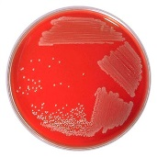

Genomic Epidemiology is here
GenomeTrakr (tracking bacteria)
Cluster 1
culturable
Cluster 2
regulatory actions: import alerts, recalls etc.
Cluster 3
Cluster 4
Genomes from historical isolates + new isolates
Genomics will provides the next generation of
molecular epidemiology tools for bacteria
Notes:
Exactly.. GenomeTrakr succesfully uses this workflow to track food-borne bacteria. For bacteria we have better/ faster ways to isolate and propagate the organism. To extract dna. The downstream is pretty similar. Create libraries, sequence, analyze.

Slide 7
Why can’t we use whole genome sequences for C. cayetanensis tracking (yet) ?
-- Large genome [~45 Mb]
-- Eukaryotic [recombination events may disturb multi-locus SNP associations]
-- Unculturable [cannot propagate/ enrich the isolate]
-- Very low contamination levels in foods
Notes:
Then what is the problem? Why cant we sequence whole genomes of C. cayetanensis? Read the slide.

Slide 8

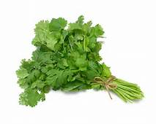
Experimental workflows to recover C. cayetanensis genomes from different type of samples
sample
sample
sample
sample
sample
Oocyst
purification
DNA
extraction
NGS
library prep
Bioinformatics
analysis
NGS
Whole genome assemblies
Apicoplast genome
Mitochondria genome
> 10⁵ purified oocysts
???
Apicoplast genome ?
Mitochondria genome ?
Notes:
To obtain whole genome assemblies, apicoplast and mitochondria genomes we need hundreds of thousands of purified oocysts. We can purify this many oocysts from some of the clinical stool samples. But for the food samples contaminated with small number of oocysts, this workflow becomes impossible to perform.

Slide 9
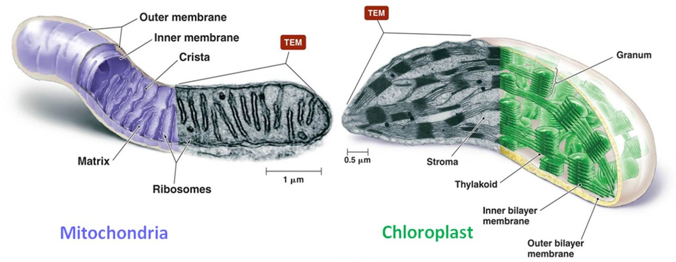
C. cayetanensis cells contain two organelles
with independent multi-copy genomes
-- mitochondria: 6.3 kb concatemer genome
-- apicoplast: 34.1 kb circular genome
Apicoplast is a non-photosynthetic plastid found in Cyclospora, Plasmodium, Toxoplasma spp.
Originated from red algae
Apicoplast is essential for viability of the parasite
Notes:
Cyclospora cayetanensis cells contain two organelles with independent genomes. These genomes are present as multiple copies in each cell. Organelle genomes have been used for molecular subtyping in other parasites such as Plasmodium species.

Slide 10
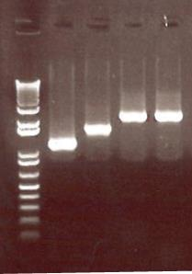
PCR design to amplify whole mitochondrial genome
1F
1R
3F
3R
6274 bp
2F
2R
4F
4R
L
A1
A2
A3
A4
Notes:
I decided to PCR amplify the whole mitochondria in four overlapping fragments Since mitochondria is in tandem repeats I was able to capture whole mitochondria without missing sequences at the beginning and the end of the genome.

Slide 11
Experimental workflows to recover C. cayetanensis genomes from different type of samples
sample
sample
sample
sample
sample
Oocyst
purification
DNA
extraction
NGS
library prep
Bioinformatics
analysis
NGS
Whole genome assemblies
Apicoplast genome
Mitochondria genome
> 10⁵ purified oocysts
sample
sample
sample
sample
sample
Oocyst
wash
DNA
extraction
PCR
NGS
library prep
Bioinformatics
analysis
NGS
200 oocysts
Mitochondria genome
Notes:
Now we have an experimental workflow which we can use to recover complete mitochondria genomes from produce samples with low level oocyst contamination, and from fecal samples directly without oocyst purification. We can recover complete mitochondria genomes from 25 g of cilantro seeded with 200 oocysts.

Slide 12
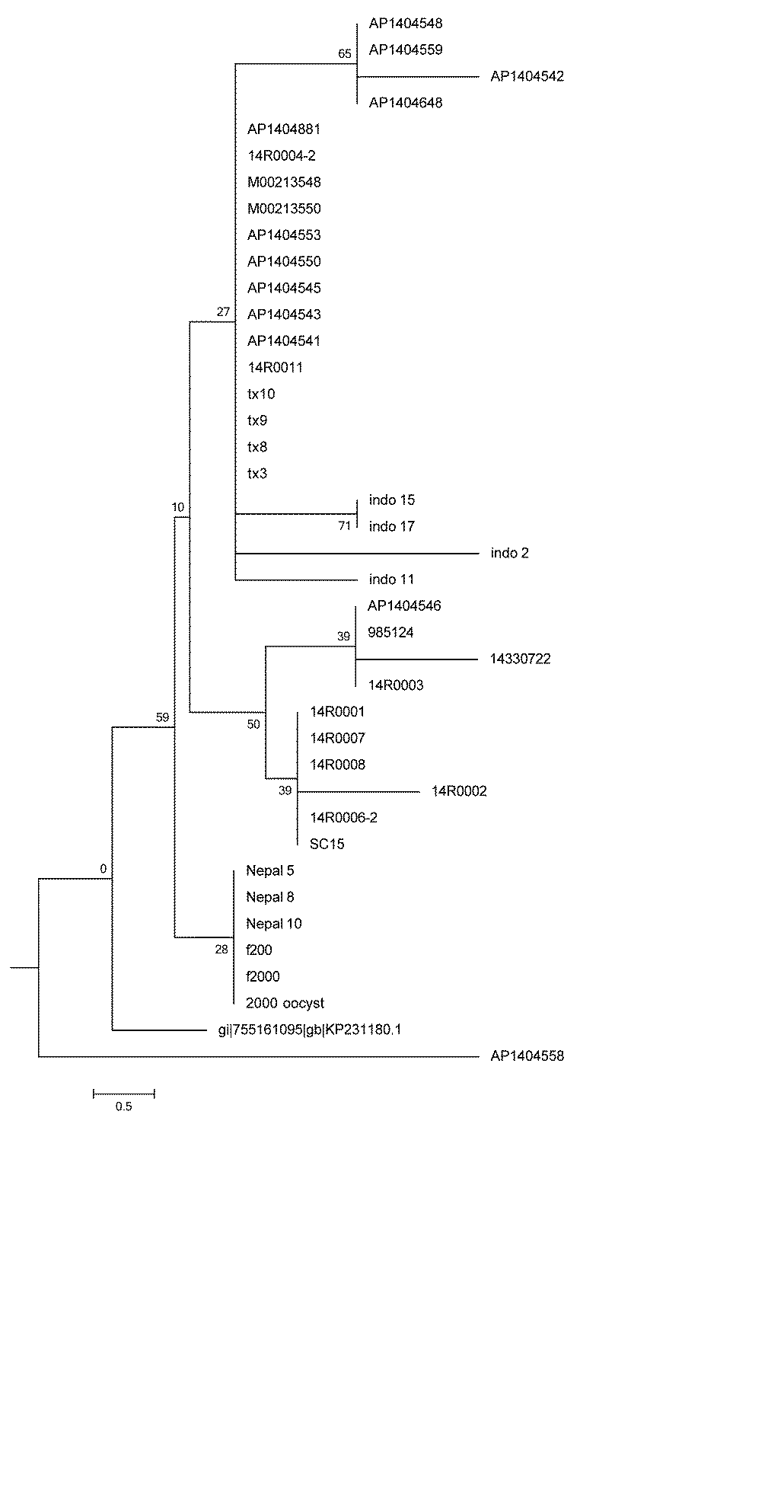
Mitochondria genome tree of 2014 C. cayetanensis US clinical samples along with isolates from Nepal and Indonesia
Texas
Massachusetts
Maine
Ohio
Montana
South Carolina
Indonesia
Nepal
Reference genome
Manuscript in preparation
Notes:
We applied this method to clinical samples from 2014 outbreak, and samples from Indonesia and Nepal. Here we see mitochondria genome tree Mainly the isolates originated from different states, or countries clustered together. These data telling us two things 1) Mitochondria genome has discriminatory power, 2) the data suggesting that outbreaks in different states could be associated with different source of contamination.

Slide 13
But…
2018 outbreak and food surveillance sample data indicate that
food contamination levels are at 5-10 oocyst per regulatory sample
We need even higher sensitivity to tackle real life food samples

Slide 14
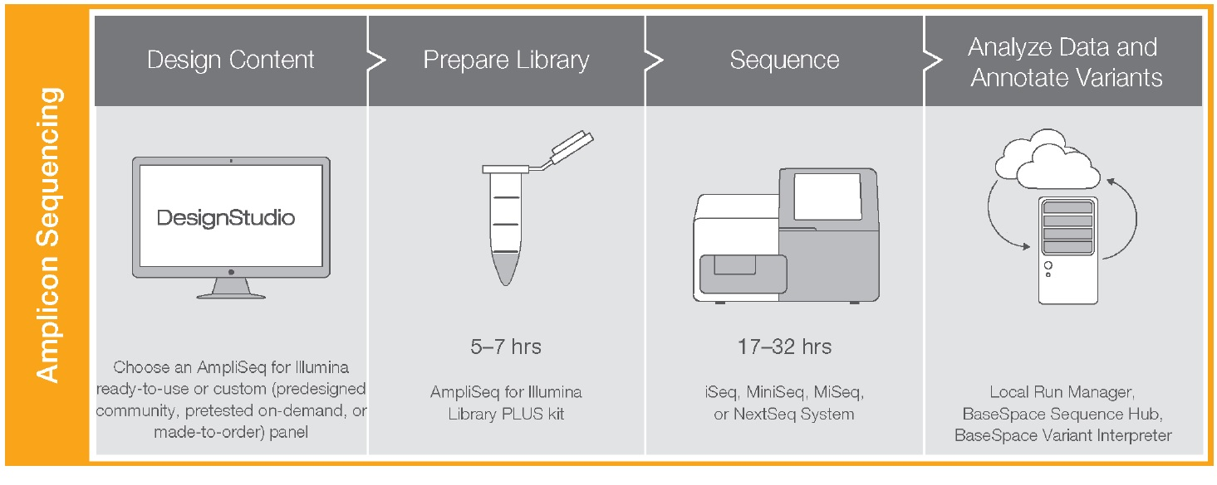
Illumina targeted sequencing: AmpliSeq
A streamlined scalable amplicon sequencing solution producing high-confidence data from low-input DNA and RNA samples
A multiplexed highly specific PCR-based workflow
A custom AmpliSeq for Illumina panel was designed to target entire mitochondria genome
Notes:
Illumina offers targeted sequencing solutions and these approaches are widely used in clinical research, especially for cancer research. I thought this might be a solution to our low input sample problem. A custom AmpliSeq Illumina panel was designed to target entire mitochondria genome.

Slide 15
Summary of Ampliseq data from various food matrices seeded with C. cayetanenesis oocysts
sample ID | matrix | number oocysts | coverage
B2 | blackberries | 5 | near complete mitochondria ~99%
B4 | blackberries | 10 | near complete mitochondria ~99%
B8 | blackberries | 200 | near complete mitochondria ~99%
PG6 | frozen pico gallo | 10 | near complete mitochondria ~99%
PG8 | frozen pico gallo | 200 | near complete mitochondria ~99%
8 | pico gallo | 20 | near complete mitochondria ~99%
9 | pico gallo | 200 | near complete mitochondria ~99%
GS1a | Green sauce | 10 | near complete mitochondria ~99%
GS1 | Green sauce | 200 | near complete mitochondria ~99%
R1 | raspberries | 5 | near complete mitochondria ~99%
1 | carrots | 10 | 622 bp missing ~90%
3 | carrots | 200 | near complete mitochondria ~99%
Notes:
We spiked different kinds of food matrixes with known number of oocysts. 5, 10, 20, 200 0ocyst spiking levels. I run Cyclospora mitochondria ampliseq protocol on the DNA extracted from these samples. All the samples yielded near complete mitochondria genomes which is about 99% of the genome, except one carrot sample seeded with 10 oocysts gave 90% recovery.

Slide 16

sample
sample
sample
sample
sample
Oocyst
purification
DNA
extraction
NGS
library prep
Bioinformatics
analysis
NGS
> 10⁵ purified oocysts
Whole genome assemblies
Apicoplast genome
Mitochondria genome
sample
sample
sample
sample
sample
Oocyst
wash
DNA
extraction
PCR
NGS
library prep
Bioinformatics
analysis
NGS
200 oocysts
Mitochondria genome
sample
sample
sample
sample
Oocyst
wash
DNA
extraction
Illumina targeted NGS
library prep
Bioinformatics
analysis
NGS
5-10 oocysts
Mitochondria genome
Notes:
With this we now added third experimental workflow where we can obtain complete mitochondria genomes from the food samples spiked with as little as 5 oocysts.

Slide 17
Genomic Epidemiology is here
CycloTrakr (tracking C. cayetanensis)
Cluster 1
Targeted sequencing of Mit. genome
Cluster 2
regulatory actions: import alerts, recalls etc.
Cluster 3
Cluster 4
Mit. genomes from clinical food and water isolates
Genomics will provide the next generation of
molecular epidemiology tools for C. cayetanensis
Notes:
If we go back to the drawing board, now finally we are in business for Cyclospora genotyping. Mitochondria genomes obtained from food clinical and environmental samples will be stored and analyzed in CycloTrakr, and data will be used to support epidemiologic investigations during Cyclospora outbreaks.

Slide 18
-- Take home messages..
-- Cyclospora cayetanensis genomics has its own challenges
-- Mitochondria genome information has discriminatory power that can be used for genotyping
-- Illumina Ampliseq targeted sequencing approach is sensitive enough to sequence
near-complete mitochondria genomes from food samples contaminated with five oocysts
-- Next steps..
-- Extend the targeted sequencing approach to apicoplast and nuclear genome targets to increase genotyping resolution

Slide 19

FDA
Parasitology team
Gopal Gopinath
Helen Murphy
Sonia Almeria
Mauricio Durigan
Laura Ewing
Alexandre da Silva (team lead)
Student interns
Jieon Lee
Yurim Shin
Jeongu Lee
Seounju Choi
Chaeyoon Lee
Dajung Choi
AnnHee Im
RaeYoung Kim
AhYoung Jang
Eunje Kim
hediye.cinar@fda.hhs.gov

Slide 21
Multicopy nature of organelle genomes help in the execution of molecular methods
 | Mean NGS read coverage (std dev) | Estimated copy number in a cell
Mitochondria genome | 1409 (125) | 133
Apicoplast genome | 805 (126) | 76
18S RNA gene | 376 (29) | 35
hsp70 gene | 21.2 (6.5) | 2
Notes:
We calculated estimated copy numbers for 18S RNA gene, apicoplast genome and mitochondria genome based on NGS coverage of the single copy gene hsp 70.

